Slide 1




Welcome to Berkswich CE Nursery

Slide 2

Meet our Berkswich Early Years Team
Mrs Gartside-Bentley – Early Years Leader and Nursery Teacher
Mrs Arkinstall – Nursery Teaching Assistant
Miss Payne – Apprentice Nursery Teaching Assistant
Miss Ennis – Teaching Assistant (Tuesday and Wednesday afternoon)
Miss Allen – Reception Teacher
Mrs Batson – Reception Teaching Assistant

Slide 3


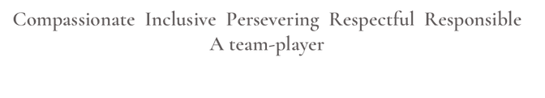
Our School Vision and Values
Our values make us who we are and help us to stay focused on what we do and how we do it.
.

Slide 4
Our Early Years Foundation Stage curriculum (EYFS)
  Children learn best through play-based activities, which we provide both in the classrooms as well as the outdoors. Adults support and facilitate their learning.
  Our Nursery is a Hygge Accredited setting.
  Hygge is the Danish Approach to living well, that focuses on being in the moment and embracing the feelings or warmth simplicity and togetherness.
  When we think about Hygge we are really focusing on the FEELING.

Slide 5
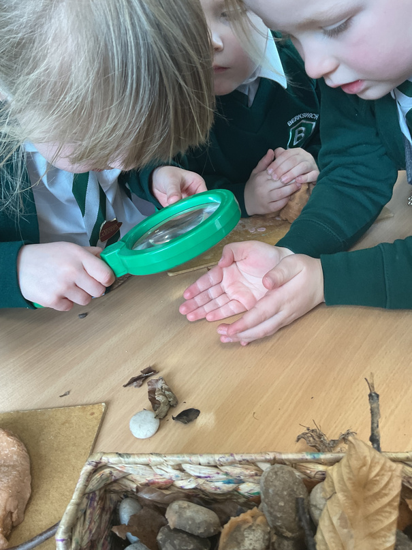
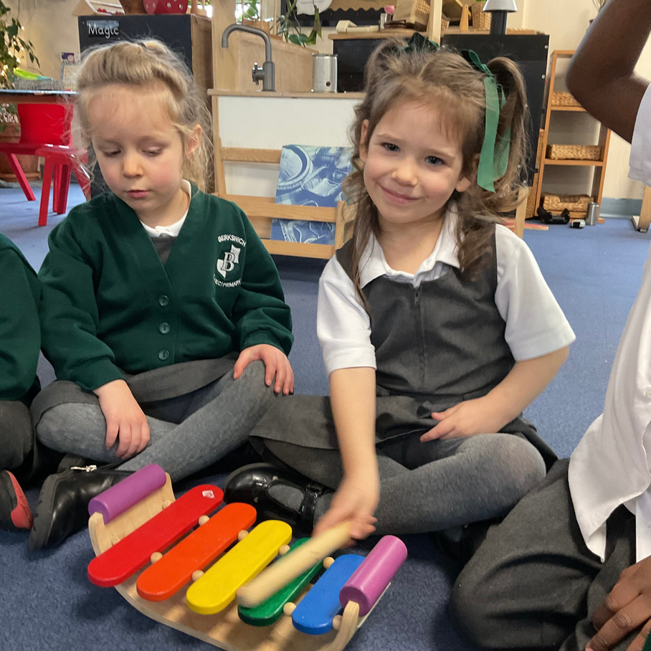

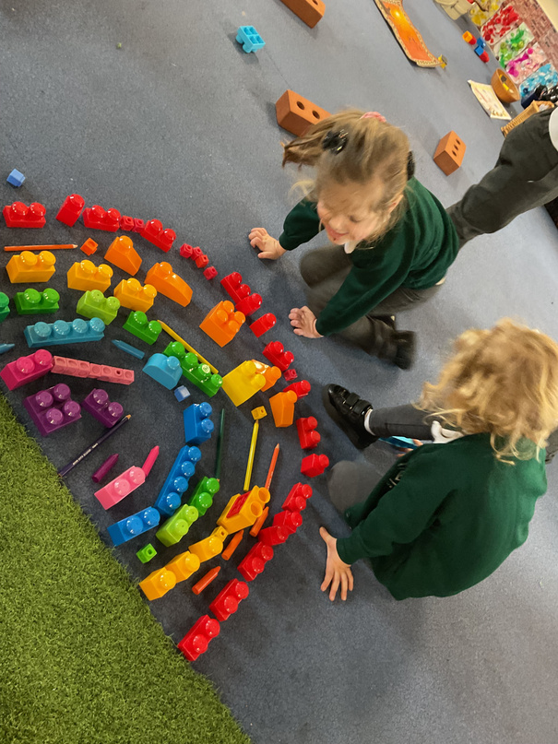
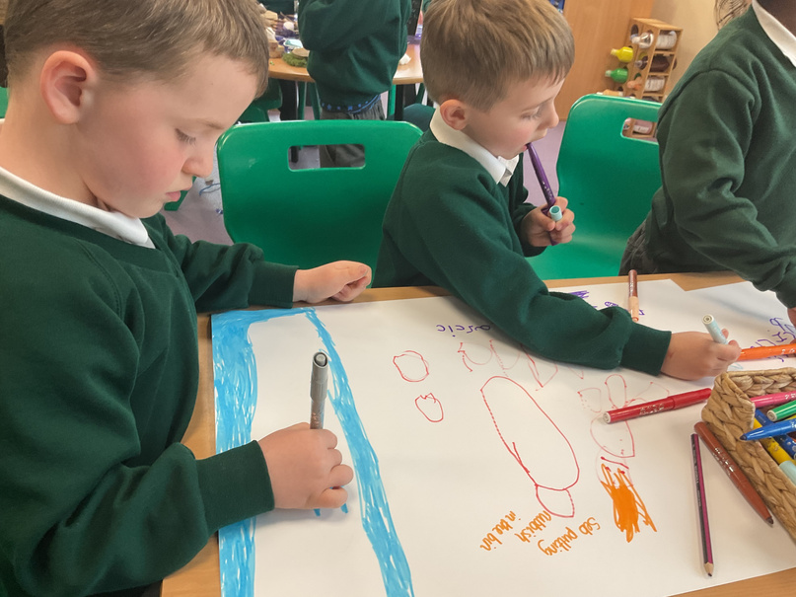
The Early Years Foundation Stage curriculum (EYFS)
There are 7 Areas of Learning in the Early Years Foundation Stage (EYFS):
Prime areas
  Communication and Language
  Personal, Social and Emotional Development
  Physical Development
Specific areas
  Maths
  Literacy
  Understanding the World
  Expressive Arts and Design

Slide 6
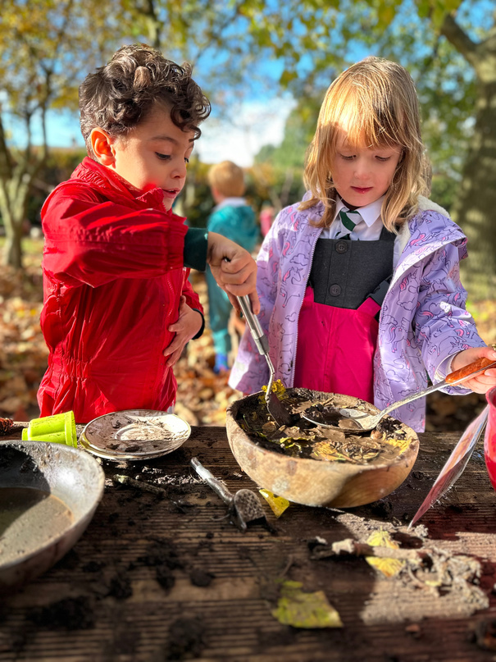
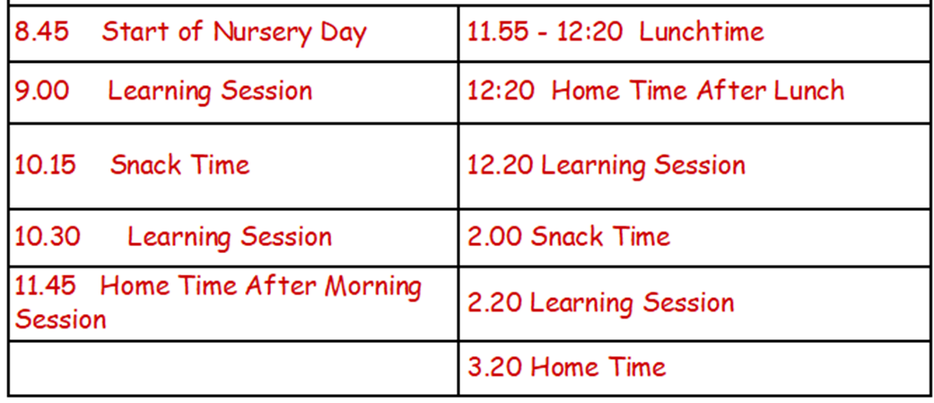
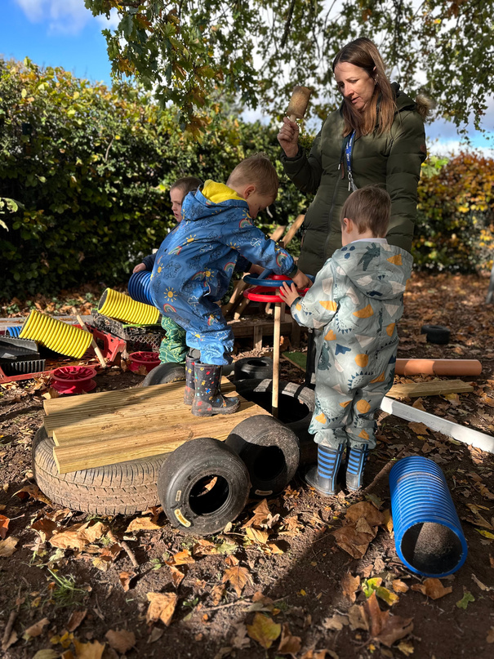
Our school day
  Doors open for children to come into school at 8.40am.
  School finishes at 3.20pm
  If you are late please enter school through the main school entrance where you can sign your child in and Mr Kelly will accompany them to class.

Slide 7
School uniform
Boys
Girls
Grey trousers
(Optional - Grey shorts when the weather is warm)
White polo shirt
Berkswich sweatshirt
Grey socks
Black shoes
Grey pinafore dress or skirt, or tailored grey school trousers
(Optional -Green and white gingham dress when the weather is warmer)
White polo shirt
Berkswich sweatshirt or cardigan
White socks or grey tights
Black shoes
Children will also need:
Children will be given a bookbag to use daily
Water bottle
Healthy snack
Drawstring bag with spare clothes to be left in school
Puddle suit and wellies to be left in school
PLEASE NAME EVERYTHING!

Slide 8


Attendance and Communication
  If your child is absent, phone the school office by 9.15am Tel: 01785 337360
  There is an answer phone, so a message can be left at any time.
  Email: office@berkswich.staffs.sch.uk
  School Gateway App
  A weekly school newsletter will be emailed to you every Friday.
  Our school website and Instagram account are a great way to keep up to date with our learning.

Slide 9

Healthy snacks
  The children are provided with a piece of fruit everyday. During morning snack time they are offered school fruit and milk.
  Please provide a healthy snack for the children to eat during afternoon snack time.
  The children are encouraged to drink water throughout the day. Please send in a named, full water bottle daily.

Slide 10
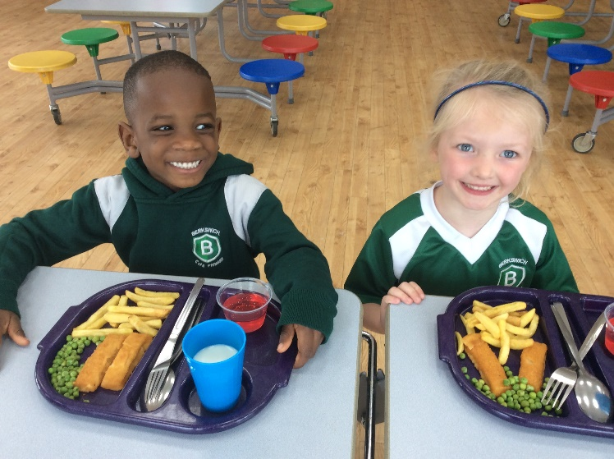
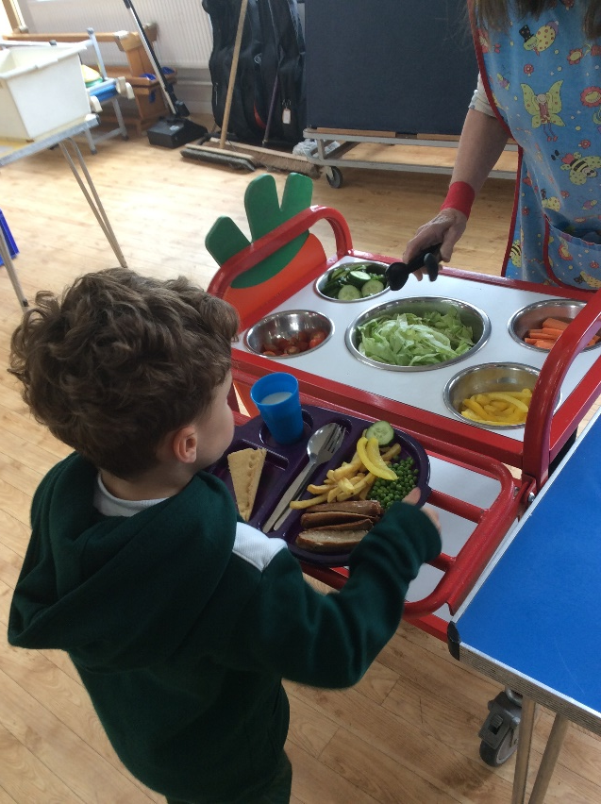
Lunchtime
  Nursery can have a school dinner or you can provide a packed lunch. There will be a selection of different meals available each day for your child to choose from. Vegetarian options are always available. Please let us know if your child has any other dietary restrictions or requirements.
  Please help the children to practise using a knife and fork.
  Healthy packed lunches please!
  We are a NUT FREE school as this can be fatal to some children in our school who suffer from nut allergies.

Slide 11

PE
  The children will have a PE session each week and lots of other opportunities for physical activity both inside and outside.
  Your child can come to school dressed in their PE kit on a Friday.
  PE Kit:
  Berkswich PE t-shirt
  Berkswich PE jumper
  Bottle green shorts
  Black slip-on pumps

Slide 12
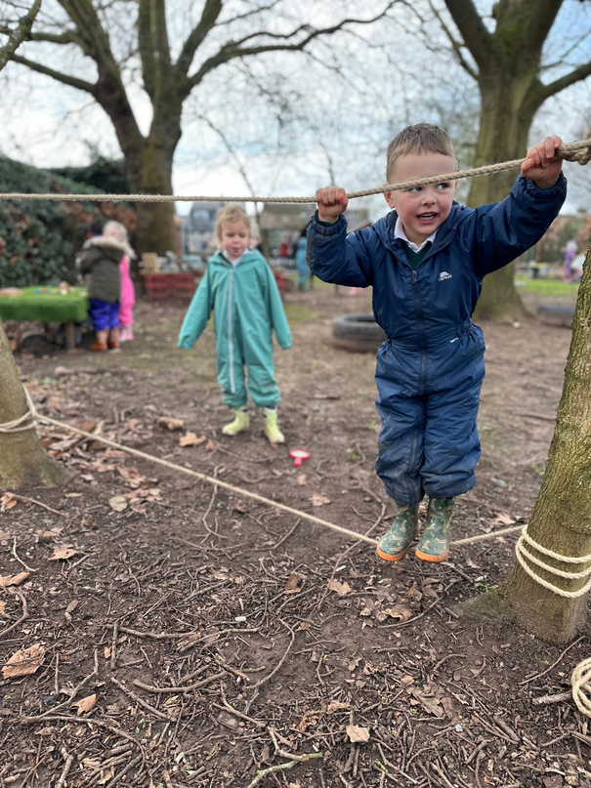

Tapestry
An Interactive Online Learning Journal
  We use Tapestry to share each child's progress through WOW moments, photographs and video.
  Tapestry allows you, as parents, to add observations and photographs of your own as well as share your comments.
  Learning and WOW moments from home and can also be shared in class.

Slide 13
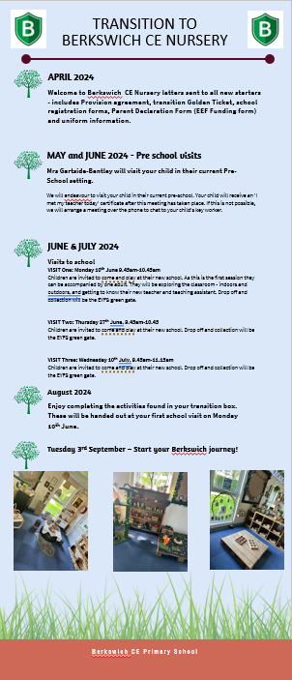

Transition into Berkswich CE Nursery
Three ways to promote a smooth transition into school.
  Current setting visit by Mrs Gartside-Bentley
  Attend as many as the transition dates as possible
  Completing the activities in your transition box

Slide 14
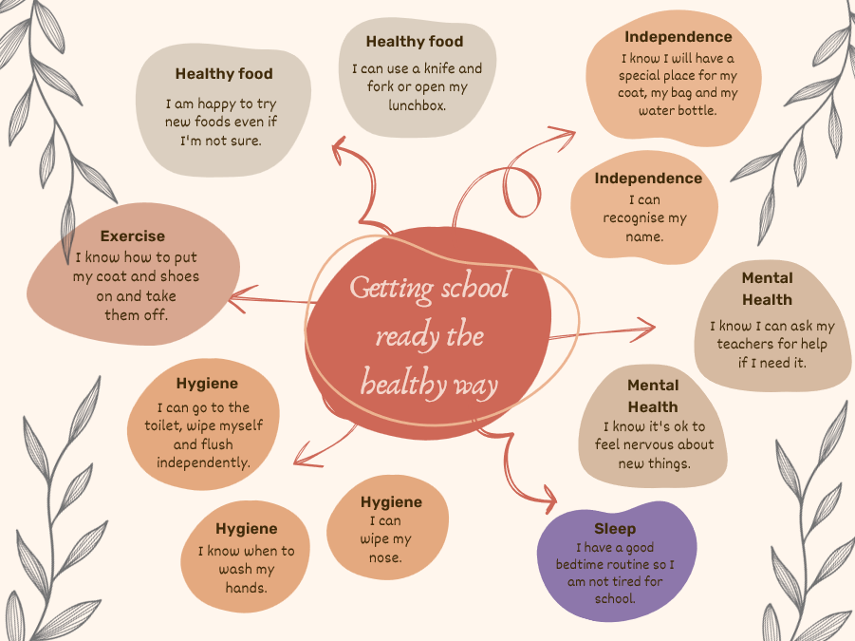
How can you help?
  Dress independently
  Use the toilet and wash hands without help
  Share lots of stories with your child and ensure there is plenty of talk
  Sing simple songs and rhymes
  Practise fine motor skills such as cutting and pencil grip
  Recognise their name

Slide 15
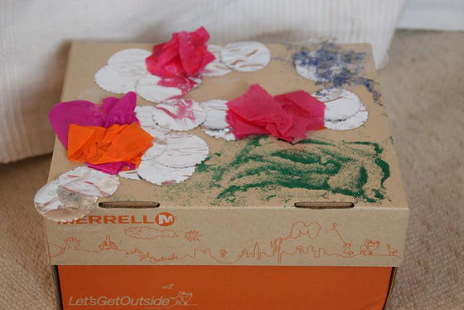
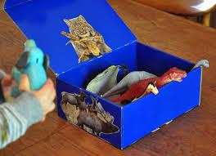
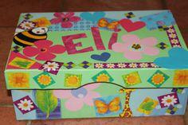
Chatter Boxes
We would like you to find a box (shoe box sized) and make your own Chatterbox. Fill it with items of interest to talk about with the class. This could be photos, pictures, small toys (not expensive ones), books, a favourite teddy, etc. These items must fit in the box and will stay at school for a couple of weeks. Be creative and decorate your box, making sure your name is visible on the top.
This will help us all to get to know each other a little more and will help us plan for your child’s interests in our lessons.
Please bring into school by Monday 9th September.

Slide 16
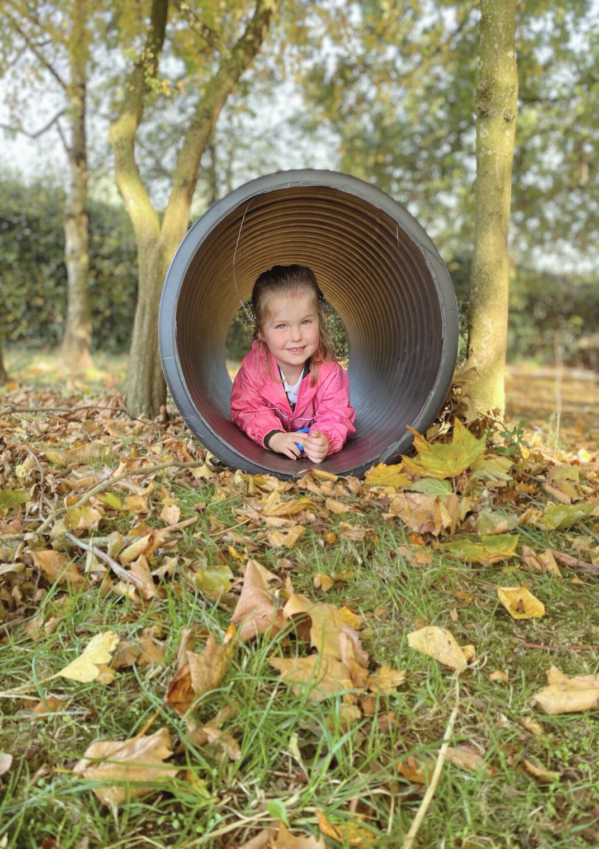
And finally … Welcome to the Berkswich family!
We look forward to working with both you and your children.
  Remember to collect your pack
  Sign and return the necessary forms
  Keep talking to us
  Relax and enjoy the next stage of your child’s development
  Our first Stay and Play will be Thursday 12th September, 2.15pm-3.20pm

