Slide 1


Spelling at Berkswich CE

Slide 2
What will be explained?
Why spelling are important in Year One
How the spelling scheme at Berkswich works
How the school teaches spellings
What you can do to help your child with their spellings

Slide 3
Why spellings are so important in Year One…
Children in Year One are taught the National Curriculum rather than the Early Years Framework.
The English language is complicated and phonetic rules don’t always apply. Many words require us to just remember them. Such words include:
  Common exception words- an umbrella term used to describe ‘tricky’ words that are not always decodable using phonics. Words like; the, where, said and of
Learning to spell the common exception words develops children’s writing and reading fluency- its one less thing to think about!
Notes:
Common exception words are words in which the English Spelling code works in an unusual or uncommon way. They are not words for which phonics 'doesn't work', but they may be exceptions to spelling rules, or words which use a particular combination of letters to represent sound patterns in a rare or unique way. Such as where, said, the and of.

Slide 4


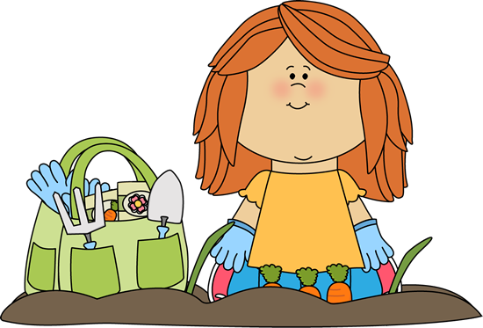






Spellings at Berkswich CE.
Super Spelling!
Super Spelling
Garden Book
Bee Book
Phase 2 and 3
Phase 4 and 5
Name __________ Class ____
Name _______ Class ____

Slide 5

Top Tips for Being a Spelling Star
Your teacher will highlight the first column in this book with the eyes. When you have shown that you can read the words several times, then you will learn to spell the words.
A highlighted box with a tick in it shows which words to learn how to spell. Please don’t tick any boxes at home.
Read each word carefully - can you sound it out or break it down into syllables?
Check that you know what the word means.
Think of a clever way to remember words (said - silly animals in dresses).
Find words inside words (they has the in it).
Think of other words that you know with the same spellings (day, play and away).
Try chanting the letters or saying them in different voices.
See if you can spot any of your words in writing around you - in stories, comics and even backs of cereal boxes!
Practise your words wherever and whenever you can.
Don’t write them with a capital letter if they do not need one - most of these words are usually in your writing without one.
Try writing the words in sentences; they are only useful if you know how to use them.
Every so often, revisit your earlier lists and check that you still know them. It is usual to have to go back and check up on a spelling.
When you reach a golden box, then you will be asked to go back and check that you know all of the words in the sets already covered. Your teacher will highlight the last box in each set, ready for your big check-up.

Slide 6
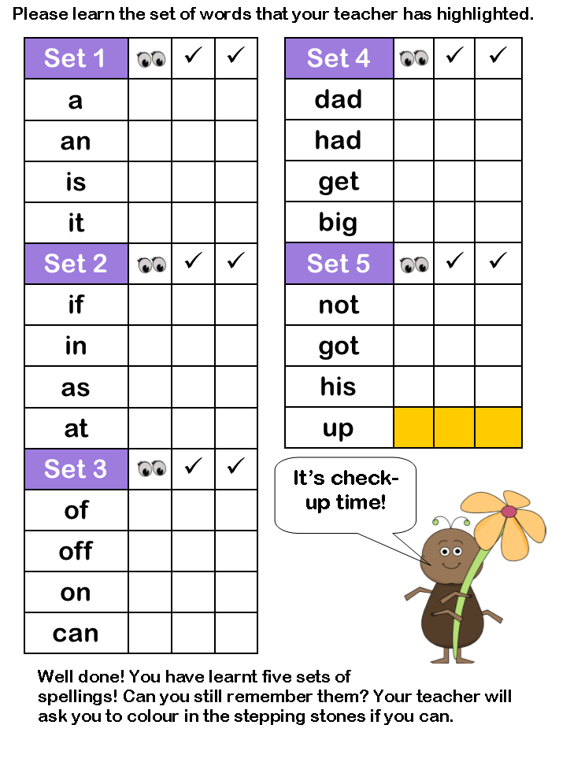
ü
ü
ü
ü
ü
ü
ü
ü
ü
ü
ü
ü
ü
ü
ü
ü
ü
ü
.
ü
ü
ü
ü
ü
ü
ü
ü
ü
ü
ü
Your child will be tested at least once every two weeks.
ü
ü
ü
ü
ü
ü
ü
ü
ü
ü
ü
ü
ü
ü
ü
ü
ü
ü
ü
ü
ü
ü
ü
ü
ü
ü
ü
ü
ü
ü

Slide 7
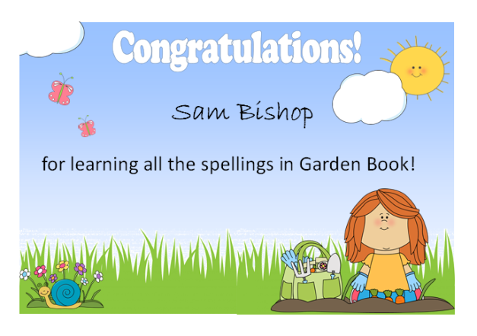

Slide 8

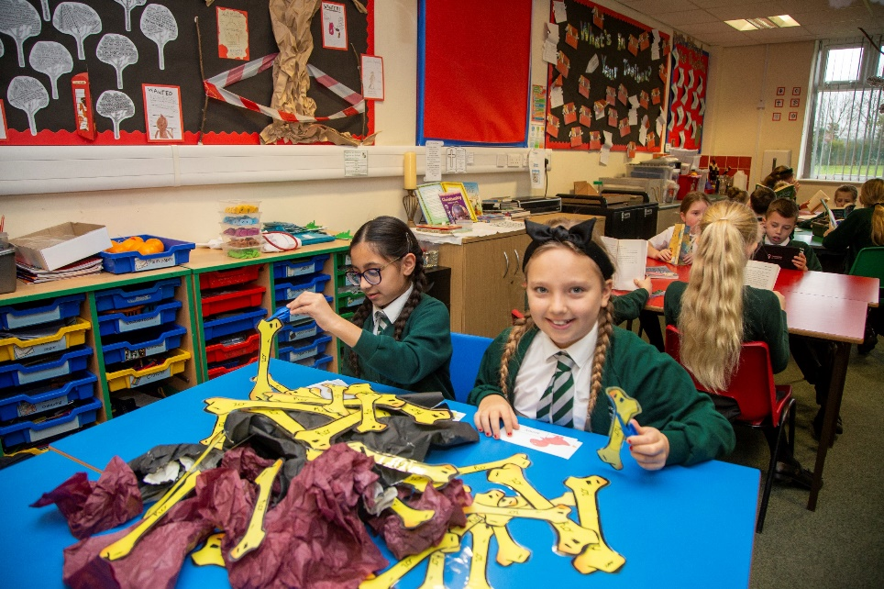
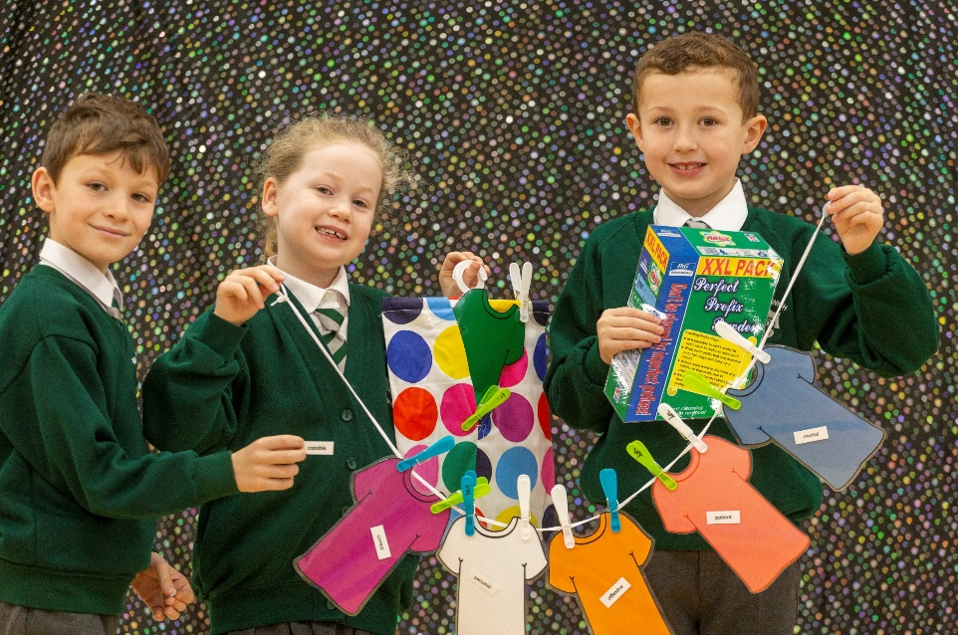
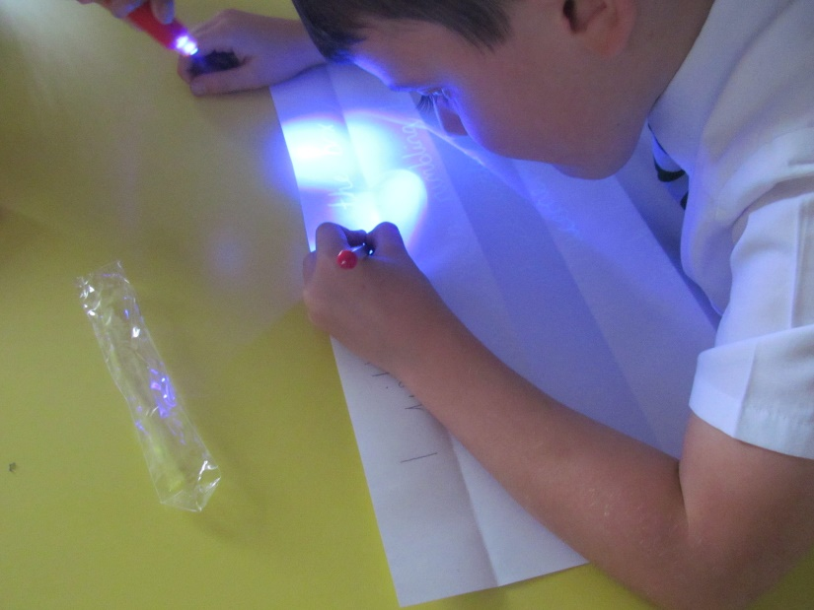
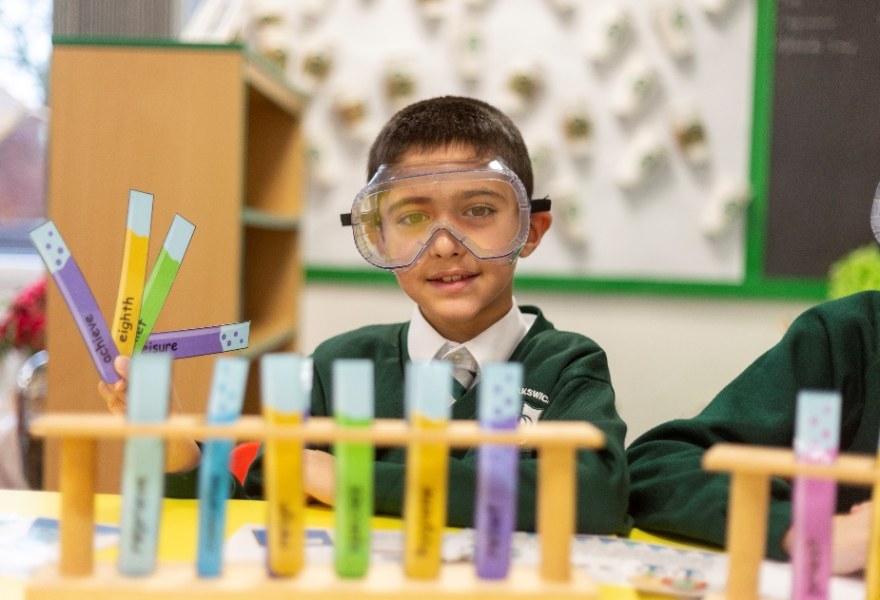
How we teach spellings at Berkswich
These are fun and practical lessons that actively encourage the children to get stuck in!
Teachers think of creative ways to investigate spelling rules to enable the children to commit this learning to their long-term memory.
Spelling
Investigations

Slide 9
In Year One…
As well as learning the 44 sounds (phonemes) that make up words and their various spellings (graphemes), the National Curriculum states that children must learn the following spelling rules in Year One:
  Adding s/es to the end of words
  Using the prefix un
  Adding ing/est/ed/er to the end of words

Slide 10
How can you help your child with Spelling?
Practise, practise, practise!
Make practising their spellings fun. Perhaps you could try:
  Giving your child a special book to use when practising
  A fancy pen or gel pen might entice them
  Practising on coloured paper
  Blackboard and chalk
  Writing in chalk on the patio
  Paint the words using water on the patio
  Can your child spot their spellings out in public?
  Have a sand tray? Why not practise writing them in sand?

