Slide 1

Teach reading: change lives
Parent workshop: Phonics and early reading

Slide 2
A love of reading is the biggest indicator of future academic success.
OECD (The Organisation for Economic Co-operation and Development)

Slide 3
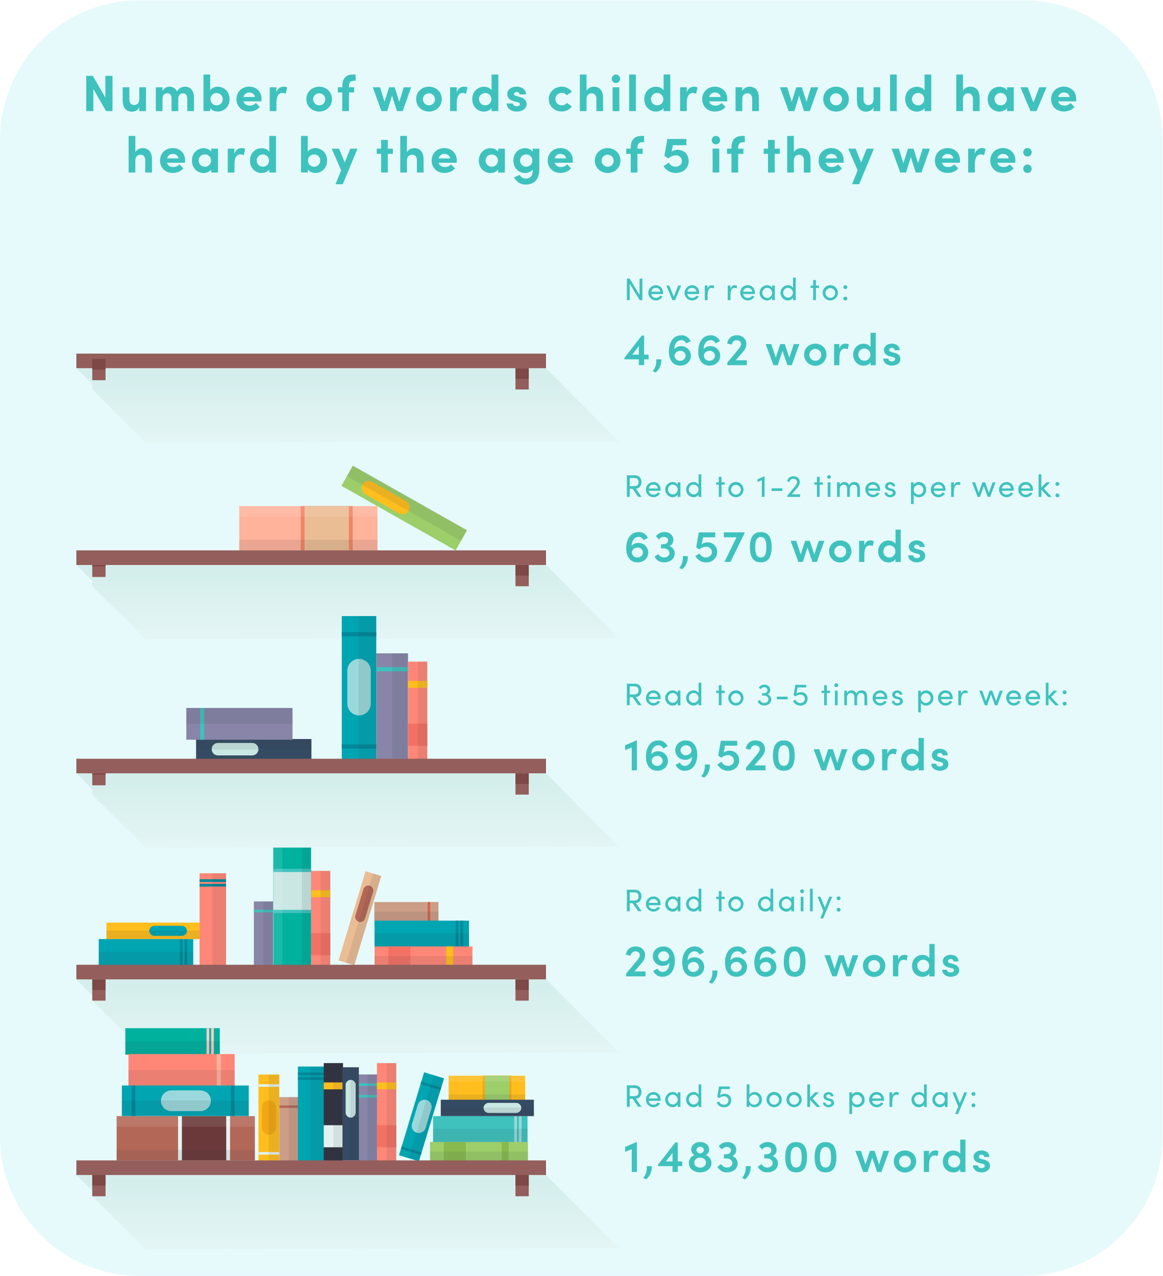
Why is reading important?
‘Reading is fundamental to education. Proficiency in reading, writing and spoken language is vital for pupils’ success. Pupils who find it difficult to learn to read are likely to struggle across the curriculum, since English is both a subject in its own right and the medium for teaching.’
The Reading Framework, July 2023
‘A good early education, particularly in reading, sets the foundation for later success.’ Ofsted strategy 2022-27

Slide 4

Phonics

Slide 5

Little Wandle Letters and Sounds Revised
Our school has chosen
Little Wandle Letters and Sounds Revised as our systematic, synthetic phonics (SSP) programme to teach early reading and spelling.

Slide 6
Phonics is:
making connections between the sounds of our spoken words and the letters that are used to write them down.
Notes:
It sounds complicated but it really isn’t!

Slide 7
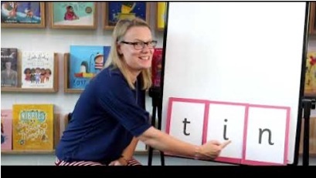
Blending to read words
https://www.littlewandlelettersandsounds.org.uk/resources/for-parents/
Notes:
Some children learn to blend really quickly, and others take a little longer. If your child is finding it difficult, ask your child’s teacher for ways to help at home – playing blending games at home is so helpful!
Show parents this video from the website: https://www.littlewandlelettersandsounds.org.uk/resources/for-parents/

Slide 8
Terminology
Phoneme
Split vowel digraph
Grapheme
Blend
Digraph
Segment
Trigraph
Notes:
Explain what each word means – use our glossary to help: https://www.littlewandlelettersandsounds.org.uk/resources/my-letters-and-sounds/getting-started/

Slide 9

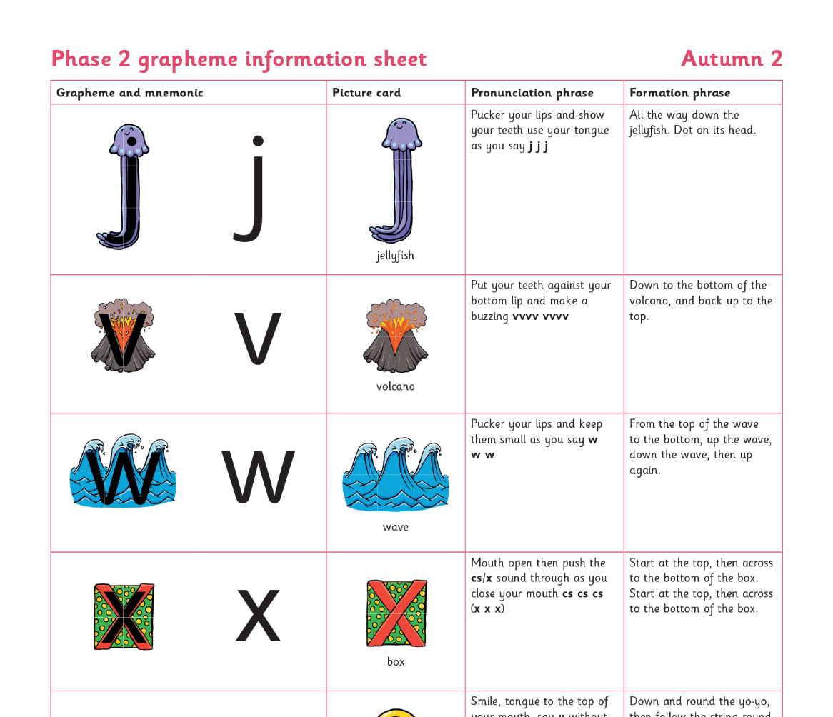
Teaching order in Reception
Notes:
We usually teach four new sounds a week and have a review lesson on a Friday. You will get a list of the sounds that we are learning to have at home. This will help you with formation and pronunciation.

Slide 10
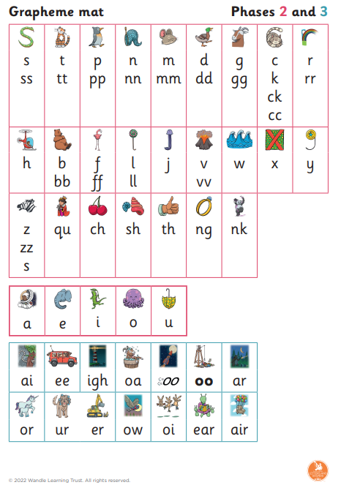
Supporting your child in Reception
Practise identifying the graphemes. Make this as fun as possible (hiding games, using the stairs, whilst you are out)
Practise the formation phrases.
As children are learning digraphs, practise the phrases with them and look for these in words.
Ensure you have the Phase 2 and 3 Grapheme mat out when your child is completing any homework for them to refer to and increase independence.
Orally decode words as much as possible. “Lets go and put on your c-oa-t”

Slide 11


Gradually your child learns the entire alphabetic code:
Notes:
We will work our way through the whole Little Wandle Programme until your child can read fluently.

Slide 12
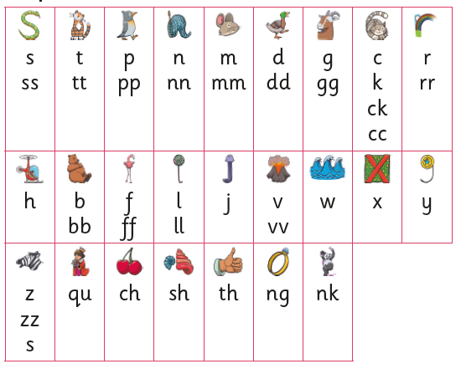

Slide 13
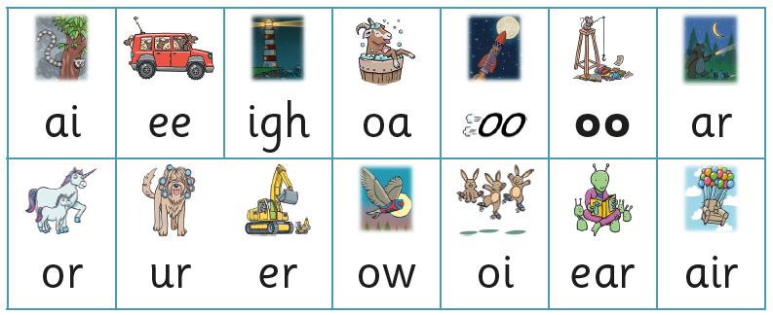

Slide 14
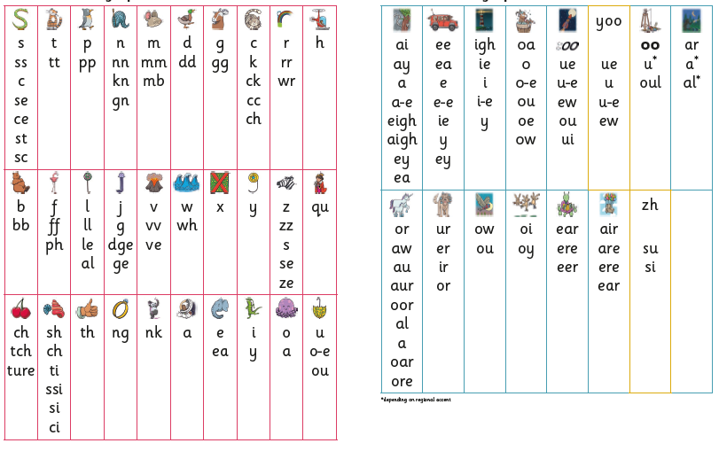

Slide 15






How we make learning stick
Notes:
There are specific resources for the Little Wandle Programme which the children will be very familiar with. Each sound that we teach to begin with has either a mnemonic (like the astronaut that you can see here) or a phrase like boing-boing for ‘oi’. This helps the children recognise and remember the graphemes. Every time we teach a new sound, we also read words during the phonics lesson that contain that new sound so that the children practise what they have learned. We then go on to reading a sentence containing some of those words. We have displays in the classroom and on the tables to support the children throughout the day.

Slide 16
How to support your child in Year One
Practise spotting digraphs and trigraphs in words
Practise blending
Practise recognising tricky words- please see resource
Sounding out in their heads
Use a Phase 3 and 5 Grapheme mat when completing any writing tasks for homework
Make practising fun! I spy games, flashcards with a timer #9can they beat their last time?), post it notes of tricky words inside cupboards on treats or on their school snack!
Little and often is the key!

Slide 17
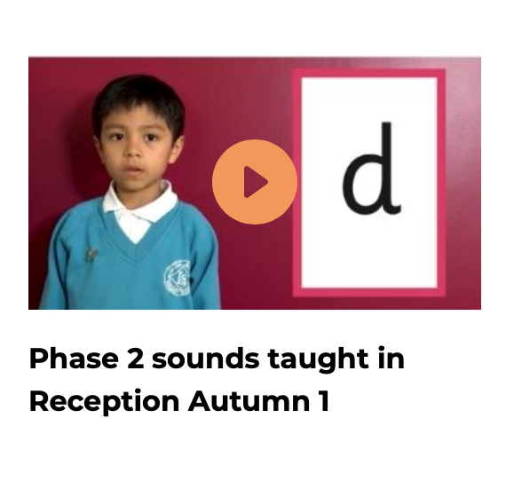
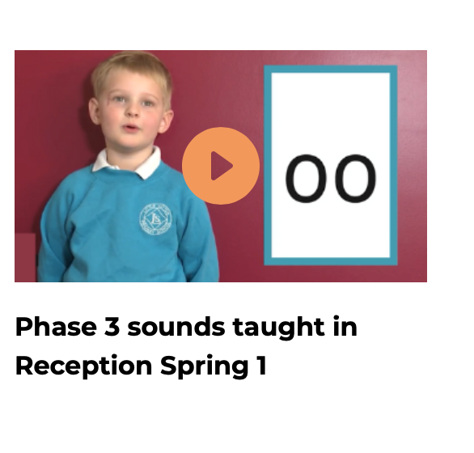
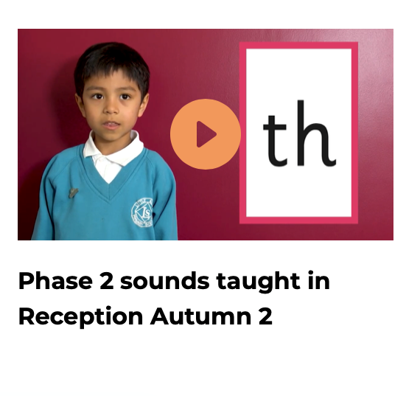
Supporting your child with phonics
Notes:
It is really important that you pronounce the sounds correctly at home if you are supporting your child. These videos are on the website for you to refer to and if you are unsure, please ask your child’s teacher.
Show the parents where to access the videos on the website and play them!
https://www.littlewandlelettersandsounds.org.uk/resources/for-parents/

Slide 18
Phonics Screening Check
Total of 40 words divided into 2 sections.
Half are ‘alien’ or pseudo-words.
Check graphemes from phase 2-5
Used to check children’s phonics knowledge, such as: their retention of the graphemes they have learnt and their blending skills.
It does not test your child’s ability to read fluently or any other reading skills (i.e comprehension)

Slide 19
Reading and spelling

Slide 20
Reading and spelling
Notes:
This is an example of what the children learn in Year 1.
Children learn that there are graphemes that can have different sounds and sounds that can be made with different letters.
Use the backs and fronts of Phase 5 cards to show ‘ea’ and ‘ow’.

Slide 21
And all the different ways to write the phoneme sh:
shell
chef
special
caption
mansion
passion

Slide 22
Tricky words
said
was
the
Notes:
Have a look at this video on the website: https://www.littlewandlelettersandsounds.org.uk/resources/for-parents/

Slide 23

Spelling
Say the word.
Segment the sounds.
Count the sounds.
Write them down.
rain
Notes:
Model the process on a flipchart for the parents to see.

Slide 24
How do we teach reading in books?
Reading practice sessions are:
timetabled three times a week
taught by a trained teacher/teaching assistant
taught in small groups.
Notes:
The children read the same book three times in a week. The first time we work on decoding (sounding out) the words, the second time we work on prosody which is reading with expression – making the book sound more interesting with our story-teller voice or our David Attenborough voice – and the third time we look at comprehension. We read the books three times at school because we want to develop the fluency. The more they see words the more they begin to read them automatically without having to sound them out.

Slide 25

We use assessment to match your child the right level of book
Notes:
We assess your child every six weeks to check progress. Any child who needs extra support has daily keep-up sessions planned for them.

Slide 26

Reading a book at the right level
This means that your child should:
Know all the sounds and tricky words in their phonics book well
Read many of the words by silent blending (in their head) – their reading will be automatic
Only need to stop and sound out about 5% of the words by the time they bring the book home – but they should be able to do this on their own.

Slide 27
Reading at home

Slide 28
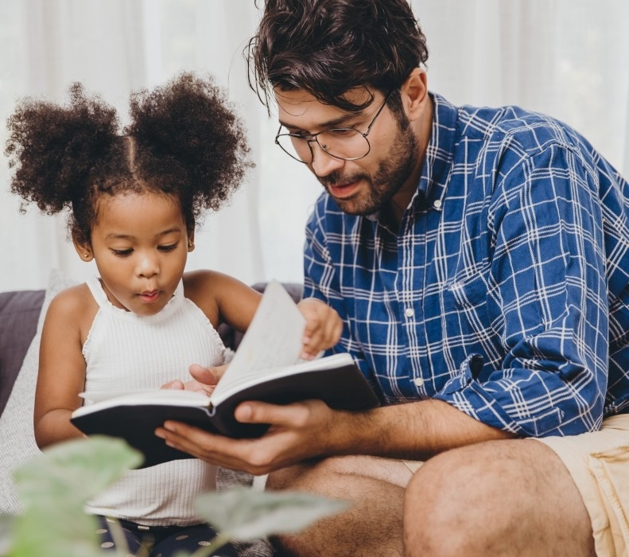
The most important thing you can do is read with your child
Reading a book and chatting had a positive impact a year later on children’s ability to…
understand words and sentences
use a wide range of vocabulary
develop listening comprehension skills.
The amount of books children were exposed to by age 6 was a positive predictor of their reading ability two years later.
Parental involvement in the development of children’s reading skills: A five-year longitudinal study (2002) Senechal, M. and Lefvre, J
Notes:
Celebrate child’s success at school, make time for reading at home!

Slide 29

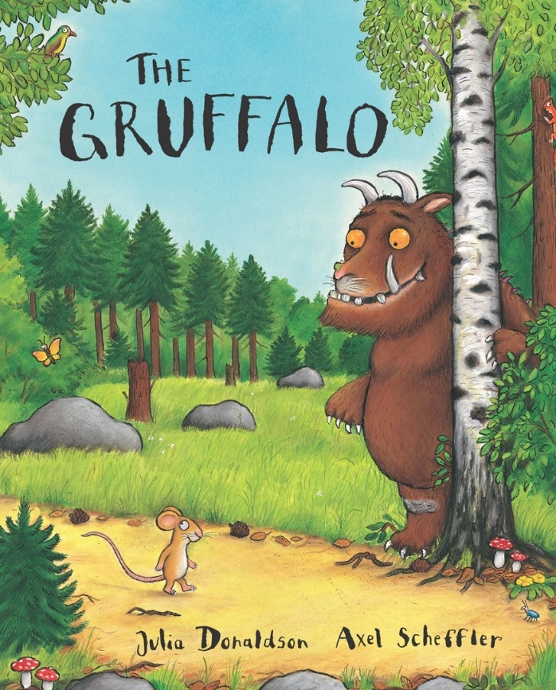
Books going home
Notes:
As well as the ‘learning to read’ book that your child will bring home they will also bring home a book for sharing with you. This book is SO important. This is how we are going to give them the WILL to read. Please read with your child as often as you can – at least once a day if possible.

Slide 30
Listening to your child read their phonics book
Your child should be able to read their book without your help.
If they can’t read a word read it to them.
Talk about the book and celebrate their success.

Slide 31

Read to your child
The shared book is for YOU to read:
Make the story sound as exciting as you can by changing your voice.
Talk with your child as much as you can:
  Introduce new and exciting language
  Encourage your child to use new vocabulary
  Make up sentences together
  Find different words to use
  Describe things you see.

Slide 32
One of the greatest gifts adults can give is to read to children
Carl Sagan

Slide 33
Any Questions?

Slide 34
Thank you

