Slide 1
A Guide to using Microsoft Teams at Berkswich
For Children and Parents

Slide 2
Logging in
All children will receive an email address in order to login to Microsoft Teams.
Go to office.com and log in there.
All the children will have access to Microsoft Teams, Word, PowerPoint, Excel and other Microsoft programmes.
Although this can be accessed on a mobile device, we recommend accessing it on a laptop, computer or tablet.

Slide 3
How does my child join a team? How do they know if they’re part of their class’ team?
To explore Teams and see the class teams they're in, your child can sign in to their school Office 365. Students will also receive an email notification when they've been added to a team or when they have a live lesson.
Screen shot when I can login as one of the children

Slide 4
Using Teams Video Calling
If a whole bubble is off, teachers will use the video calling to teach part of their lessons. The children will receive an invite to this via their email address. Parents will be notified of this by their teacher’s email address.
Screen shot when I can login as one of the children

Slide 5
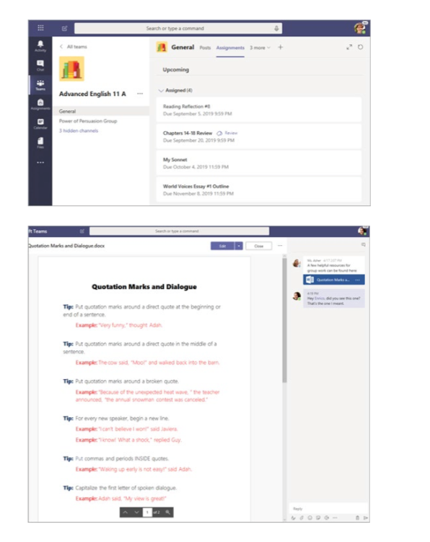
Can my child study, work, and complete assessments there as well?
With the ‘Assignments’ app built right into Teams, your child can see work their teacher have assigned them, submit that work, and see their results and feedback.

Slide 6
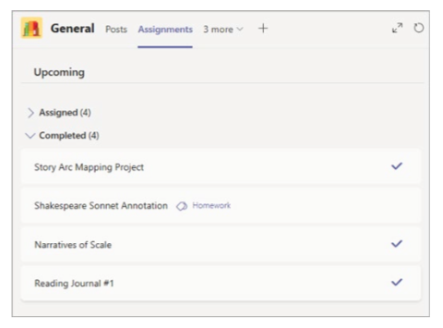
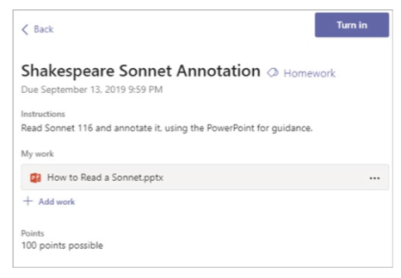
How does my child turn in assignments using Teams? Can they check the teacher’s comments in Teams?
Your child can turn in their assignments by navigating to the ‘Assignments’ tab in the ‘General’ channel of their class team, then selecting an assignment. They can attach any appropriate work and select ‘Turn in’.

Slide 7
How is it best to use Teams?
The best way to understand Teams is to trial it.
All homework will now be set on Teams, so that you can navigate it at home and, if you’ve not used it before, you can work with your child to understand how it works.
If you aren’t able to access something or are struggling with an aspect of Teams, please come and talk to the teachers. We will endeavour to help you.
Follow this link for a step-by-step guide if you need further assistance (I will add link when added to website)

