Slide 1
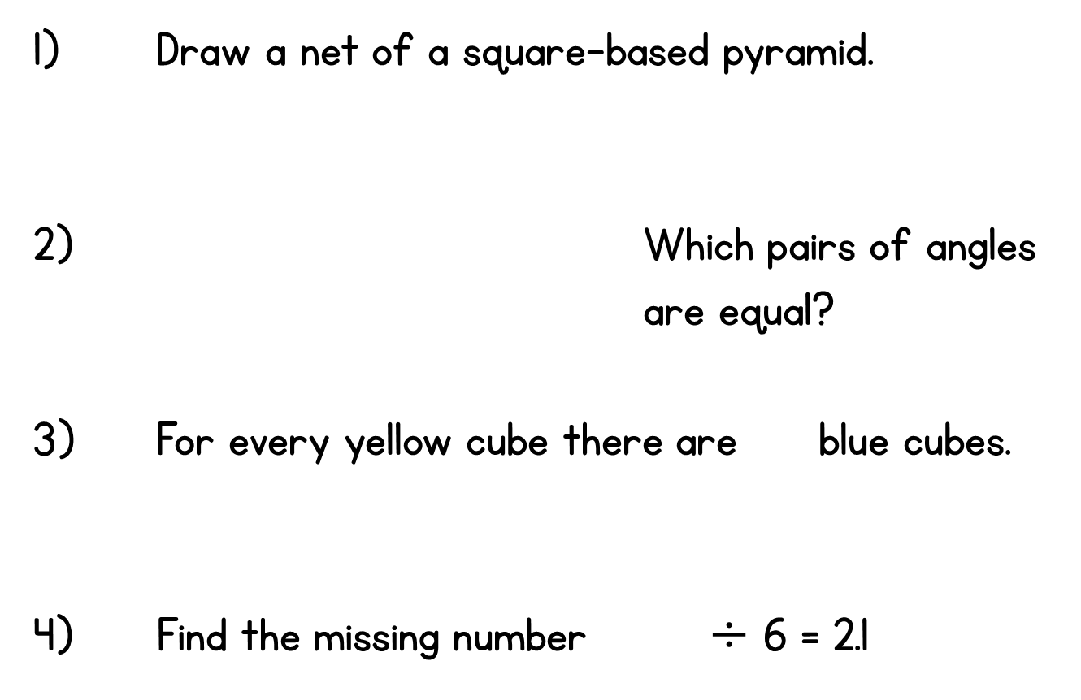


Year 6 | Week 1 | Day 1

Slide 2
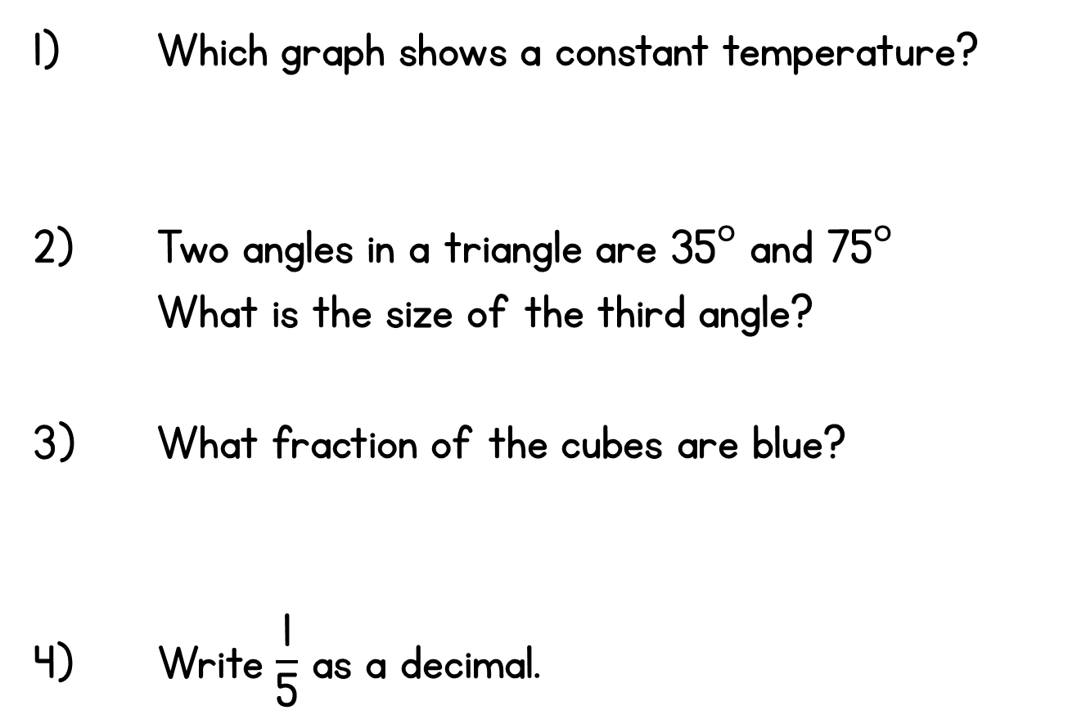



Year 6 | Week 1 | Day 2

Slide 3
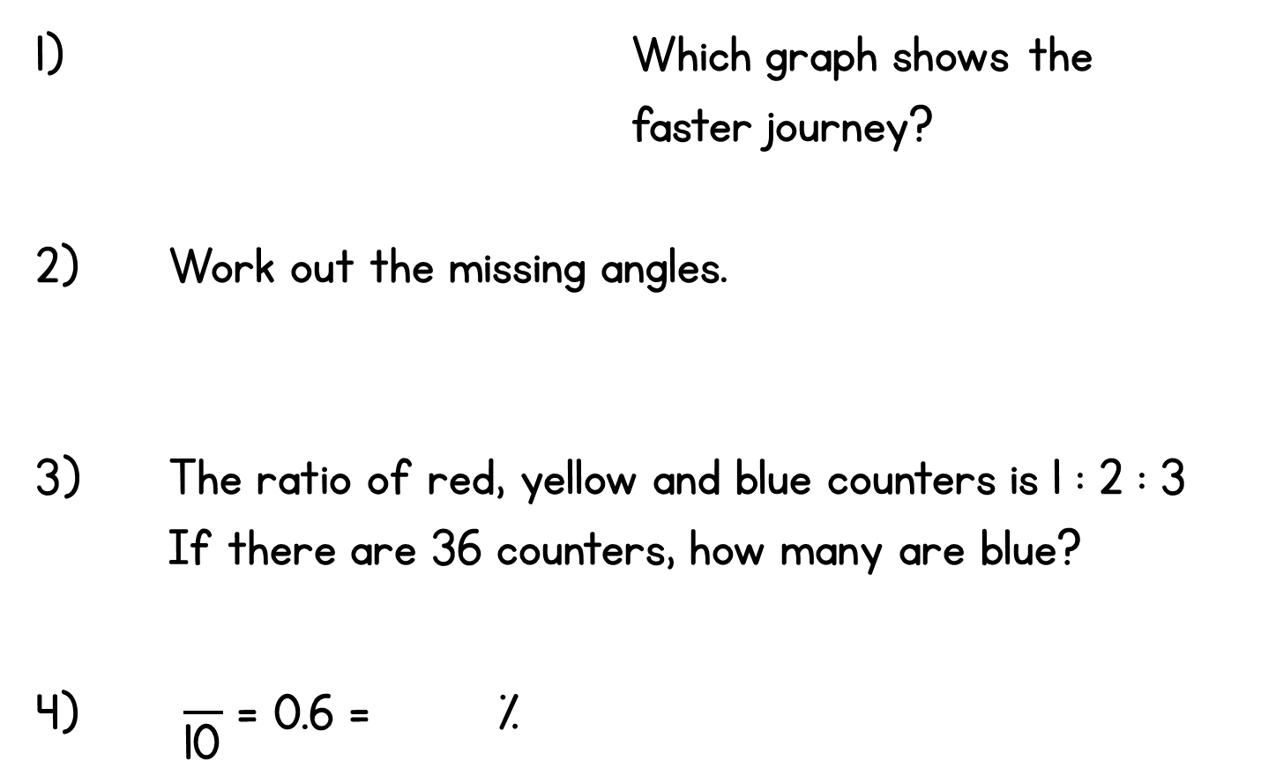
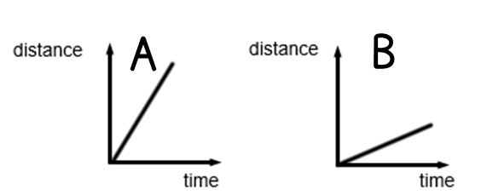
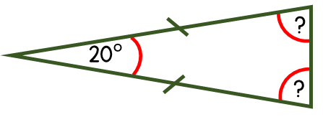
Year 6 | Week 6 | Day 3

Slide 4
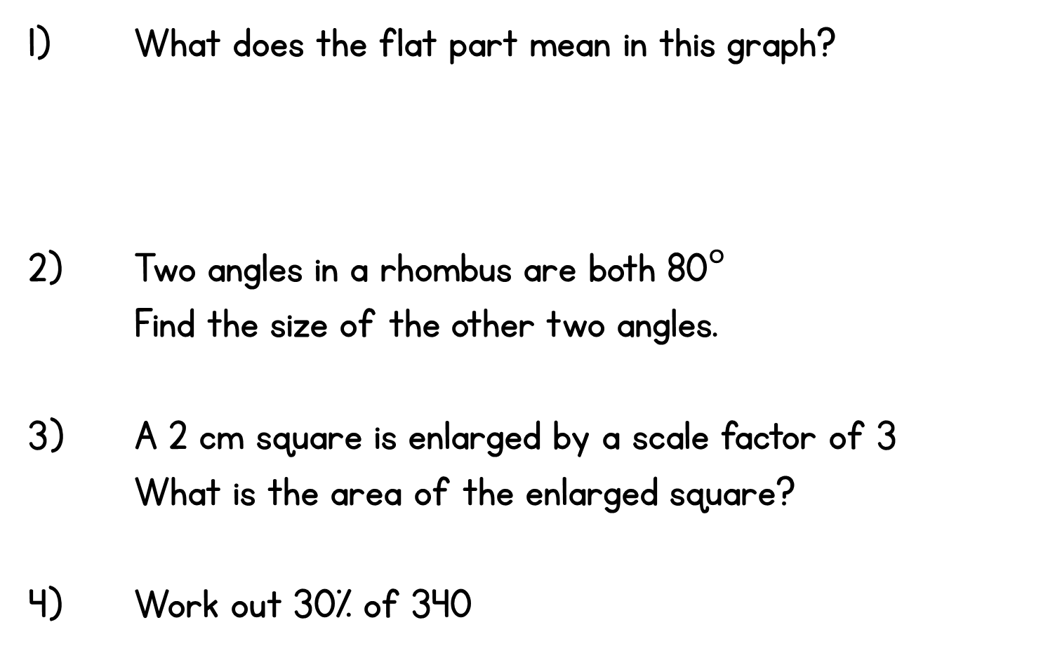
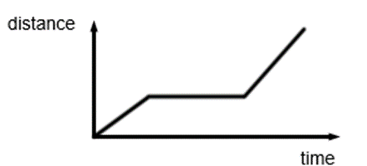
Year 6 | Week 6 | Day 4

Slide 5
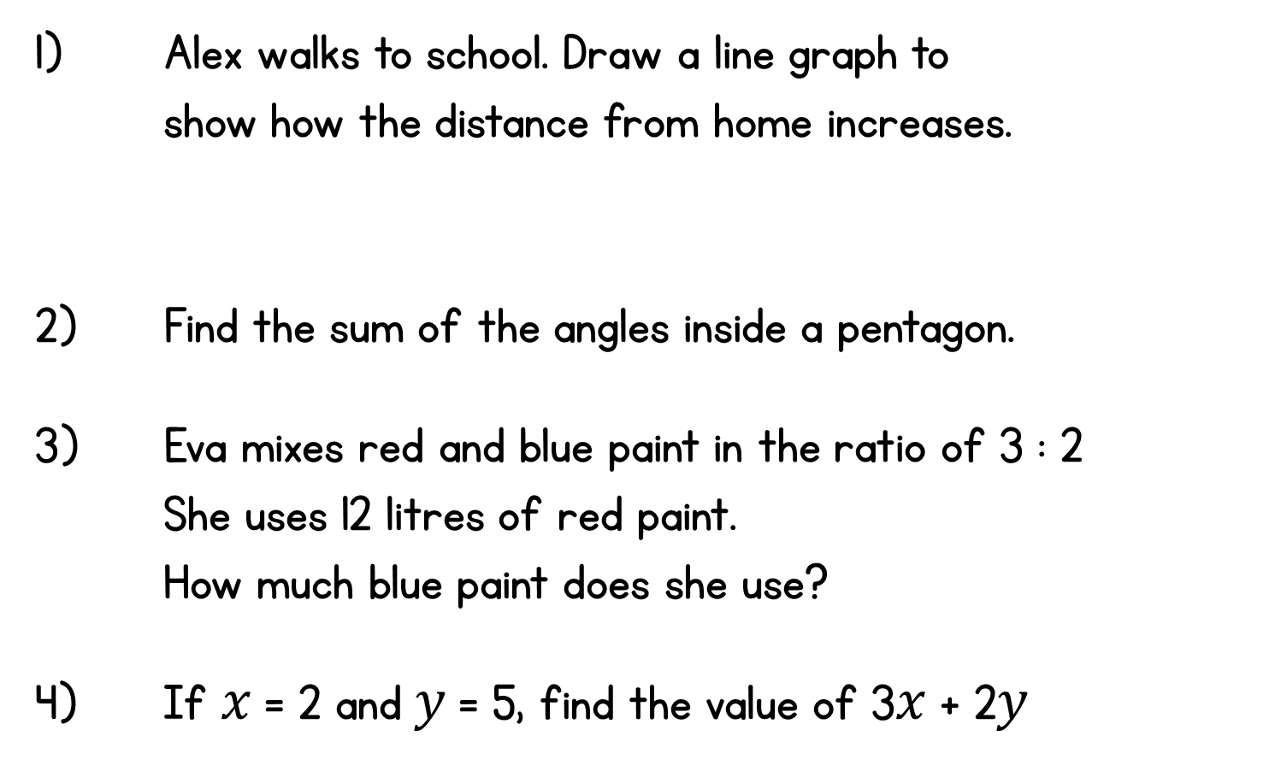
Year 6 | Week 1 | Day 5

