Slide 1

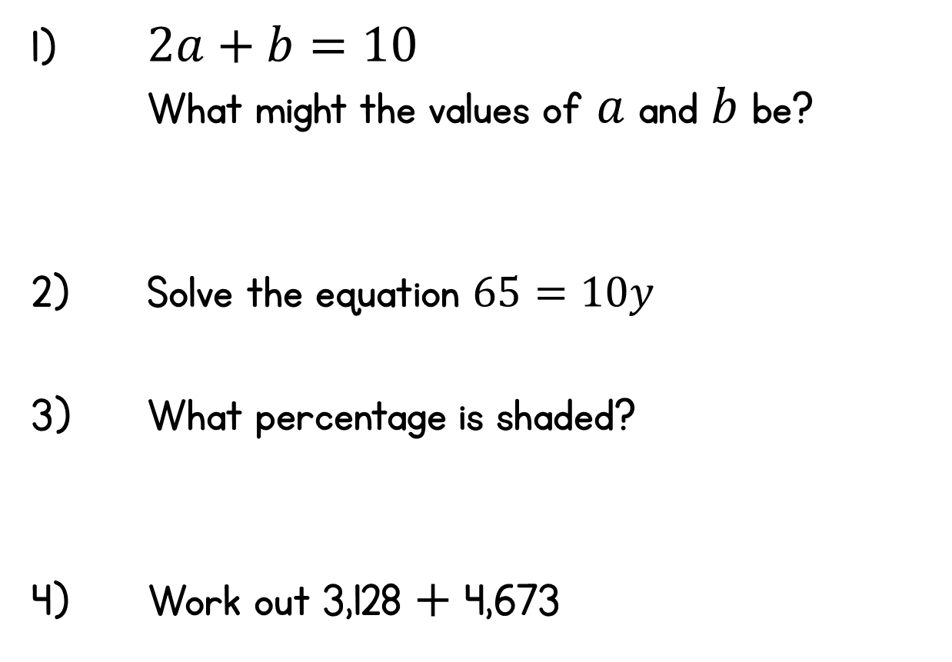
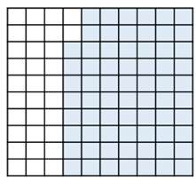
Year 6 | Week 7 | Day 1

Slide 2
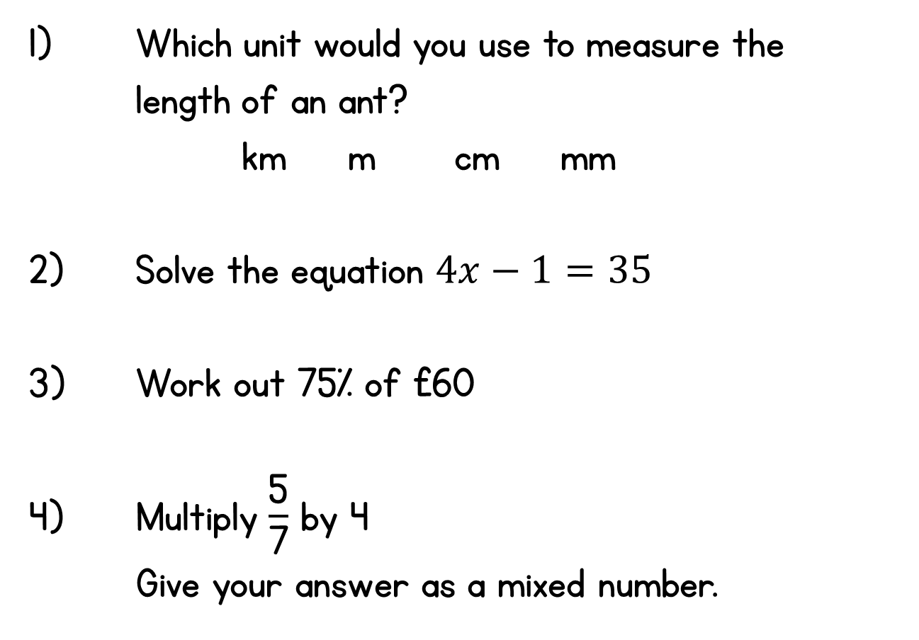
Year 6 | Week 7 | Day 2

Slide 3
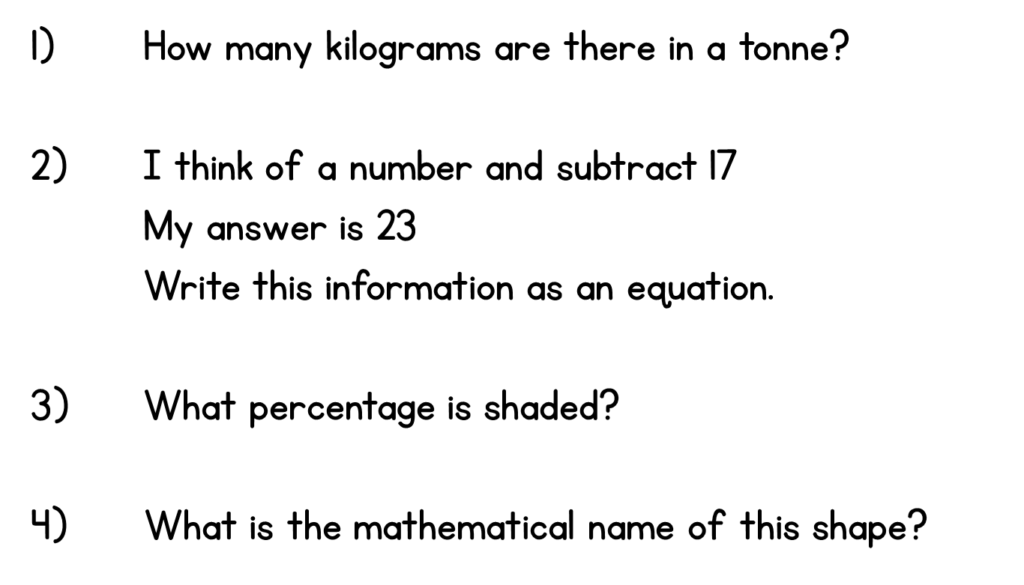
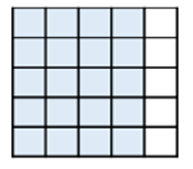

Year 6 | Week 7 | Day 3

Slide 4
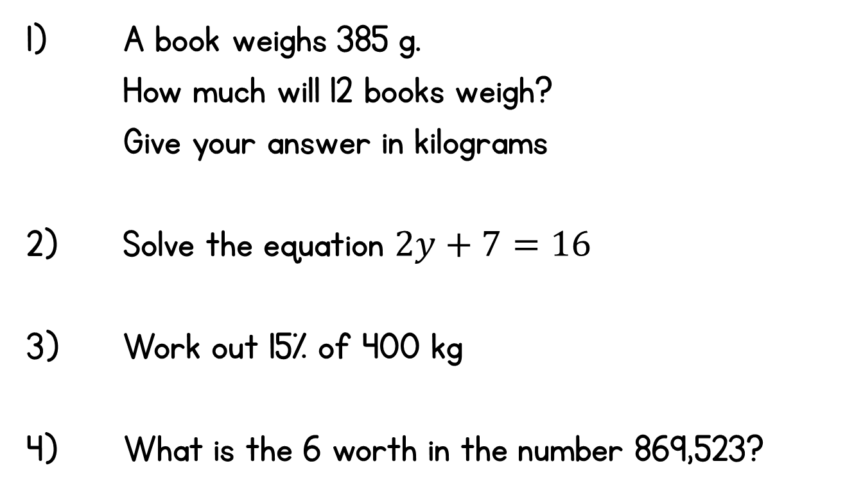
Year 6 | Week 7 | Day 4

Slide 5
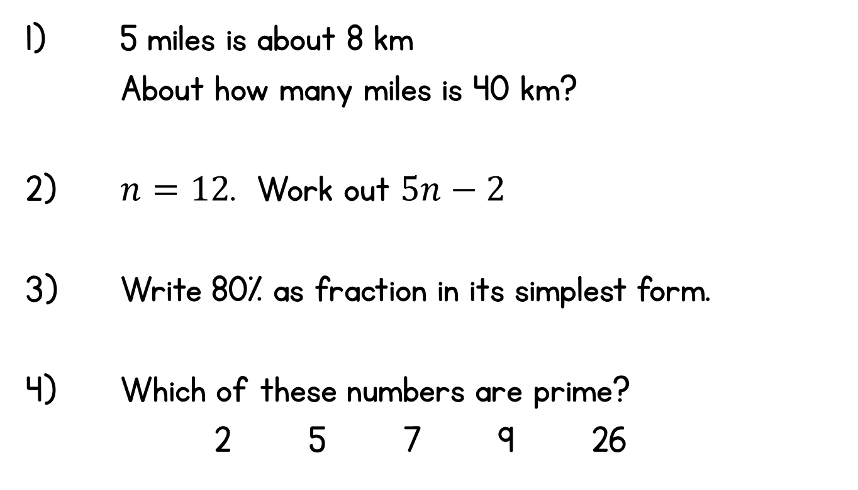
Year 6 | Week 7 | Day 5

