Slide 1

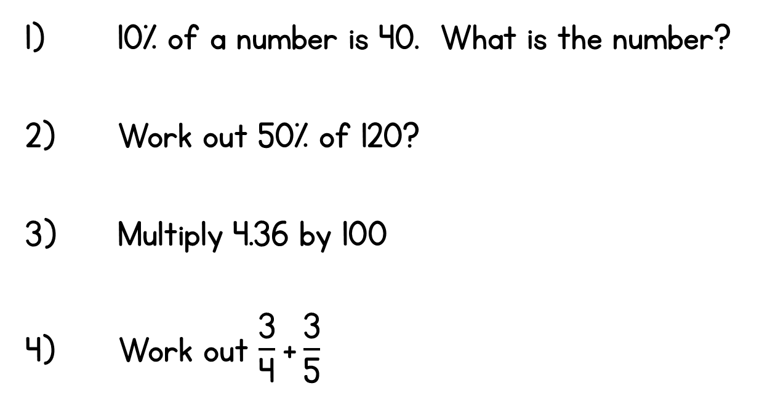
Year 6 | Week 5 | Day 1

Slide 2
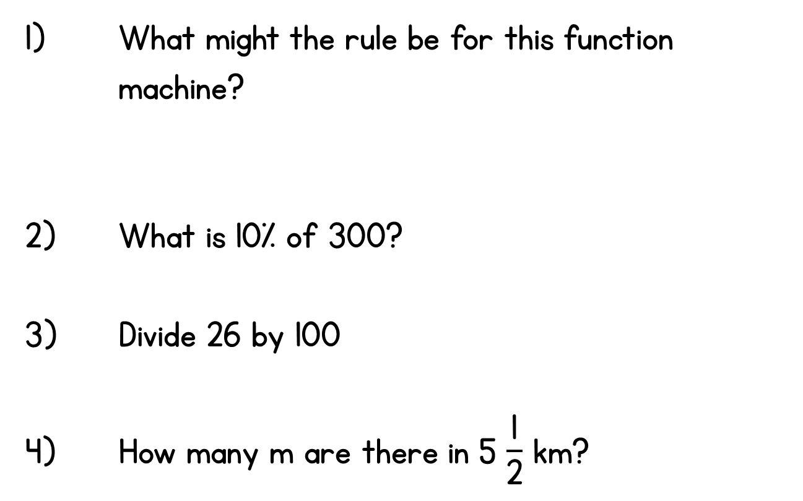
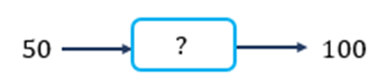
Year 6 | Week 5 | Day 2

Slide 3
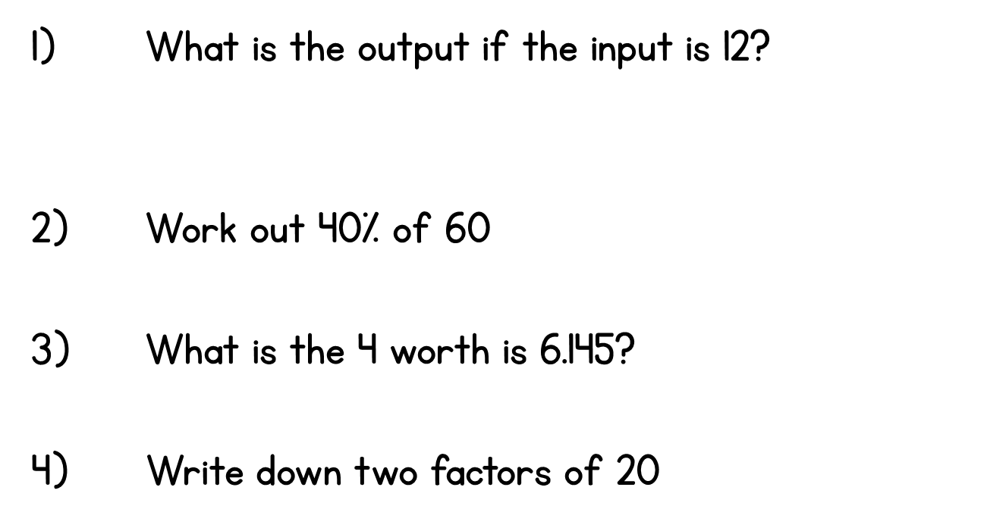
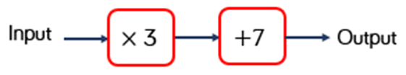
Year 6 | Week 5 | Day 3

Slide 4
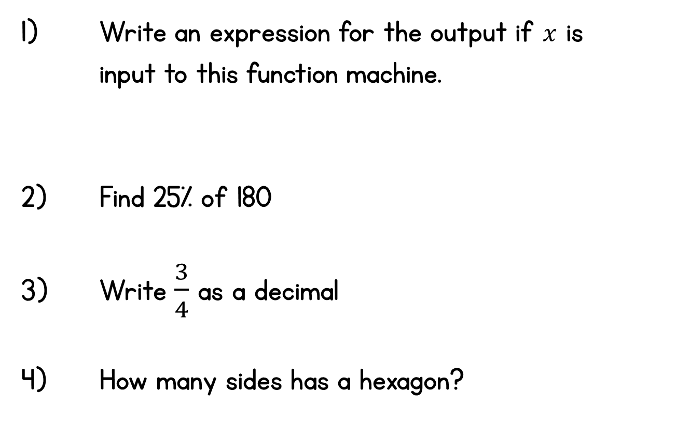
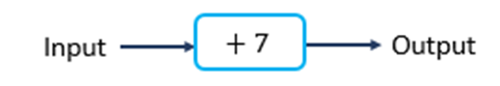
Year 6 | Week 5 | Day 4

Slide 5
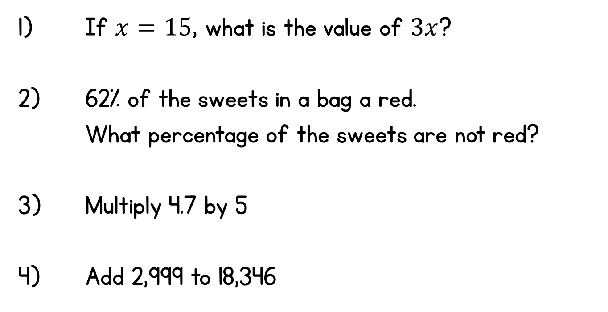
Year 6 | Week 5 | Day 5

Slide 6
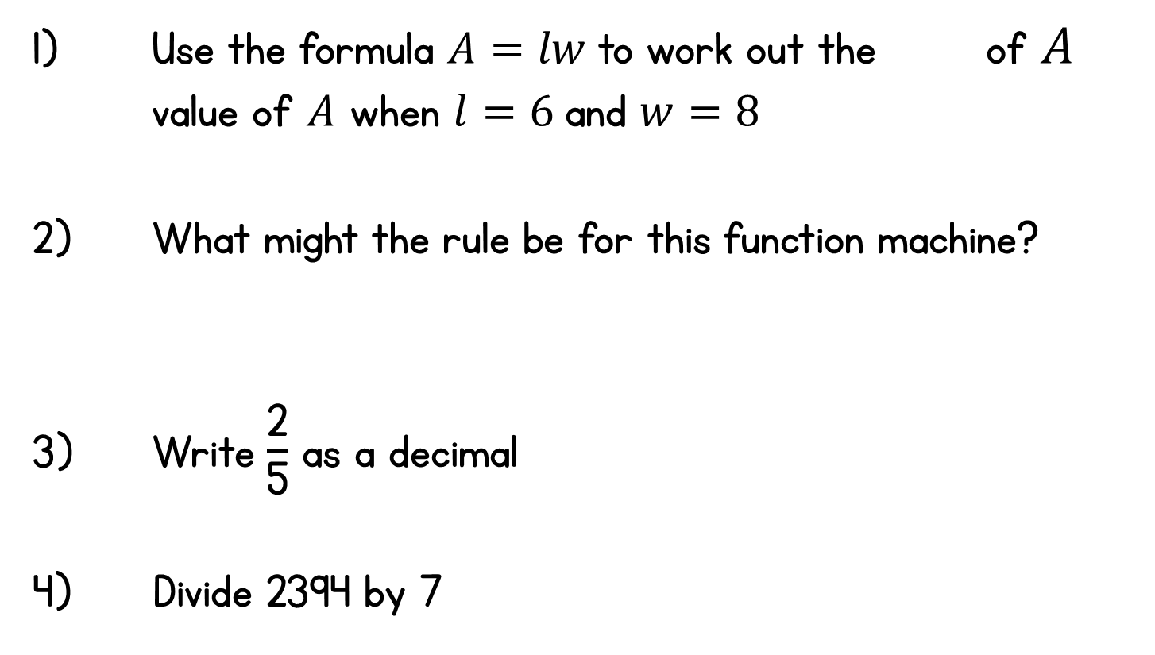
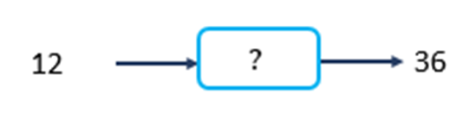
Year 6 | Week 6 | Day 1

Slide 7
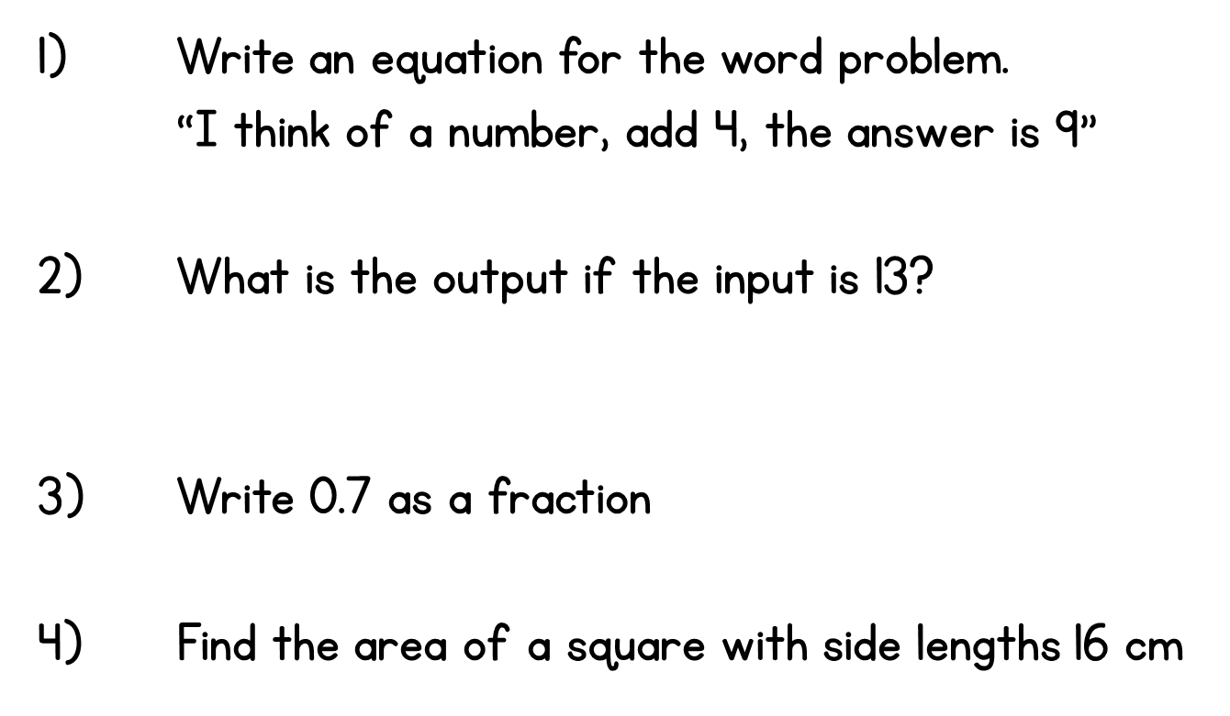

Year 6 | Week 6 | Day 2

Slide 8
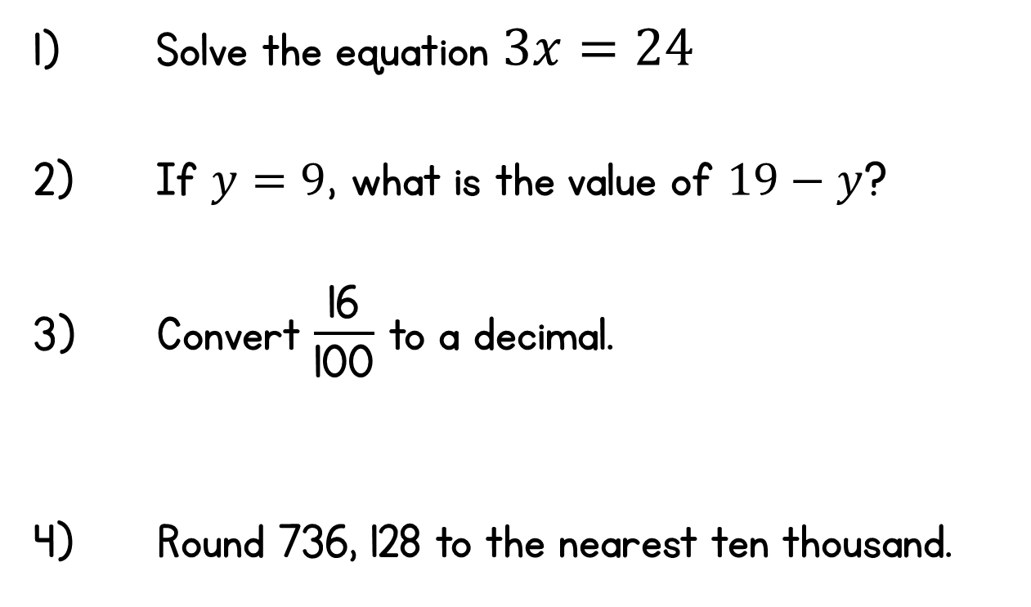
Year 6 | Week 6 | Day 3

Slide 9
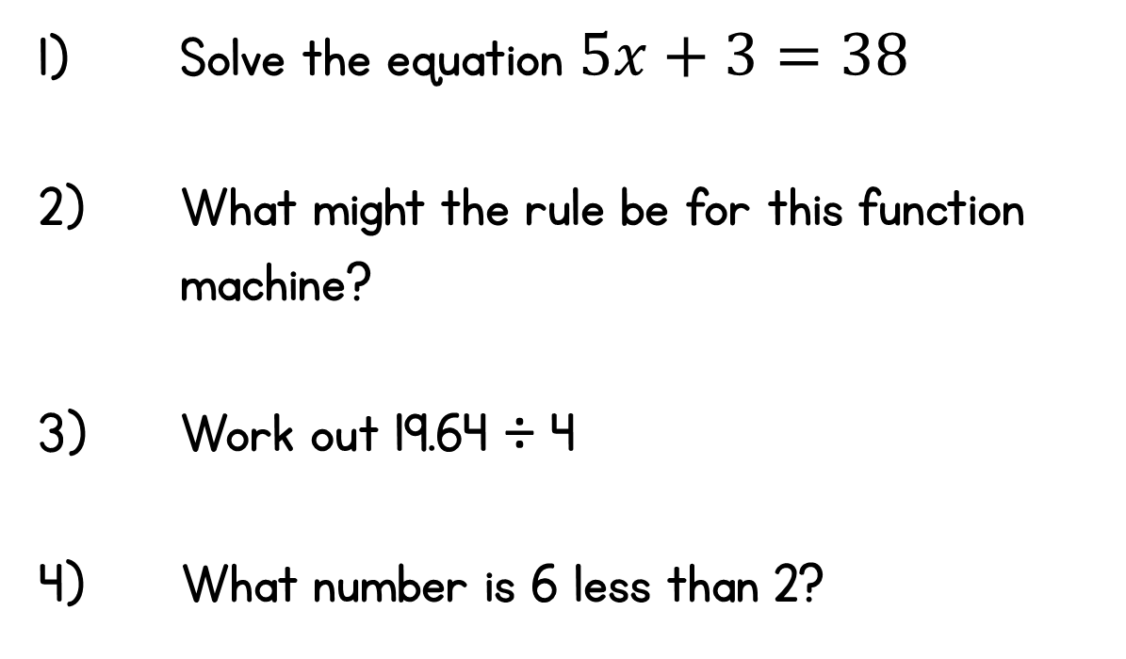

Year 6 | Week 6 | Day 4

Slide 10
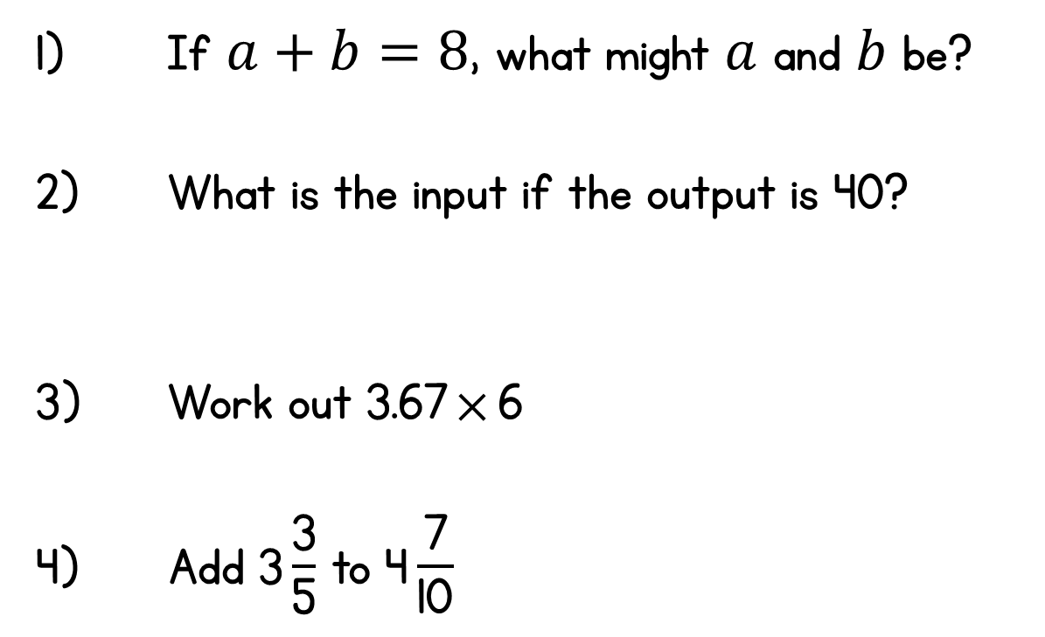
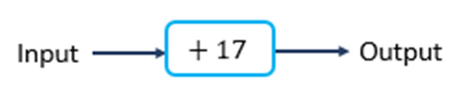
Year 6 | Week 6 | Day 5

