Slide 1

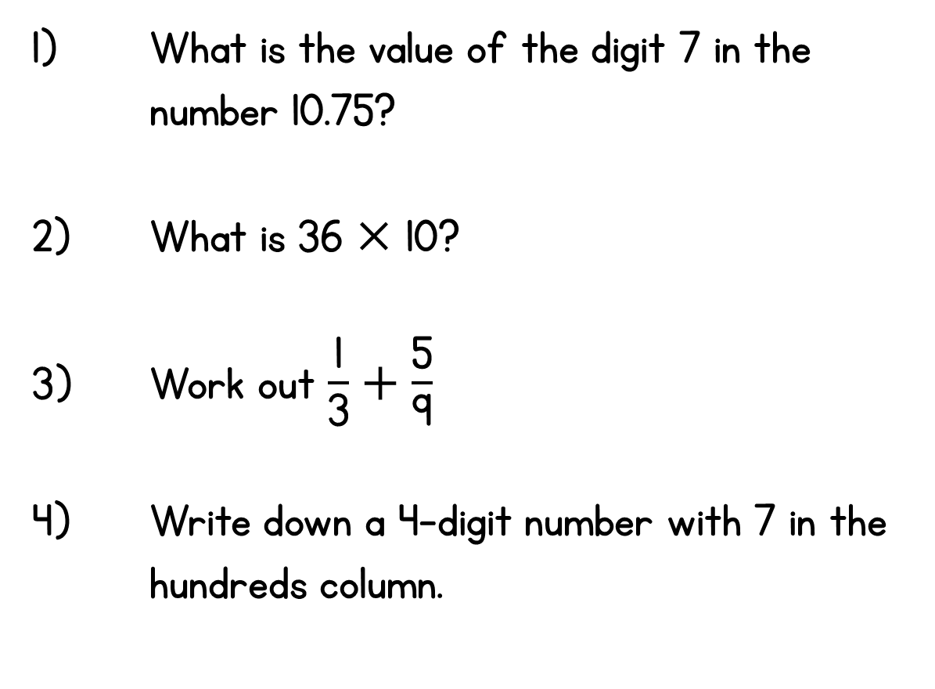
Year 6 | Week 1 | Day 1

Slide 2
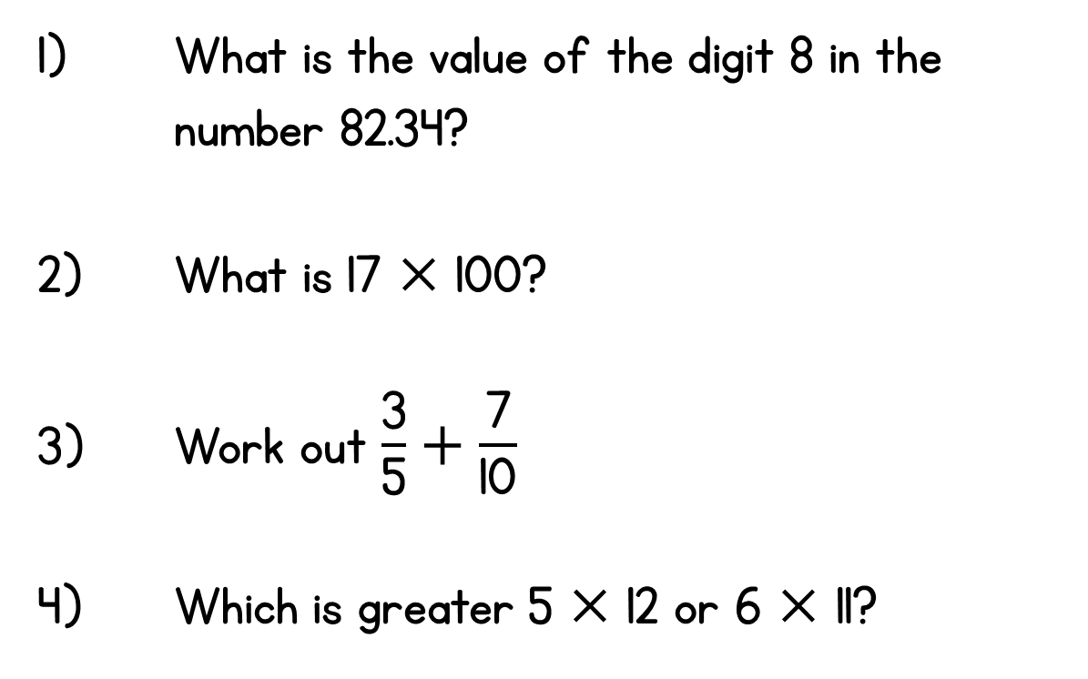
Year 6 | Week 1 | Day 2

Slide 3
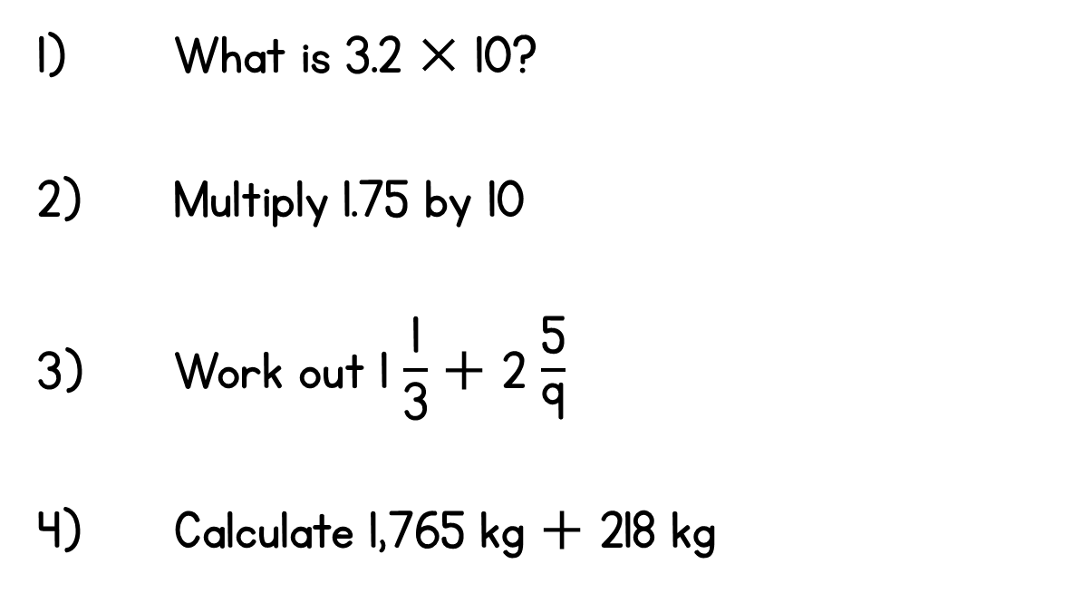
Year 6 | Week 1 | Day 3

Slide 4
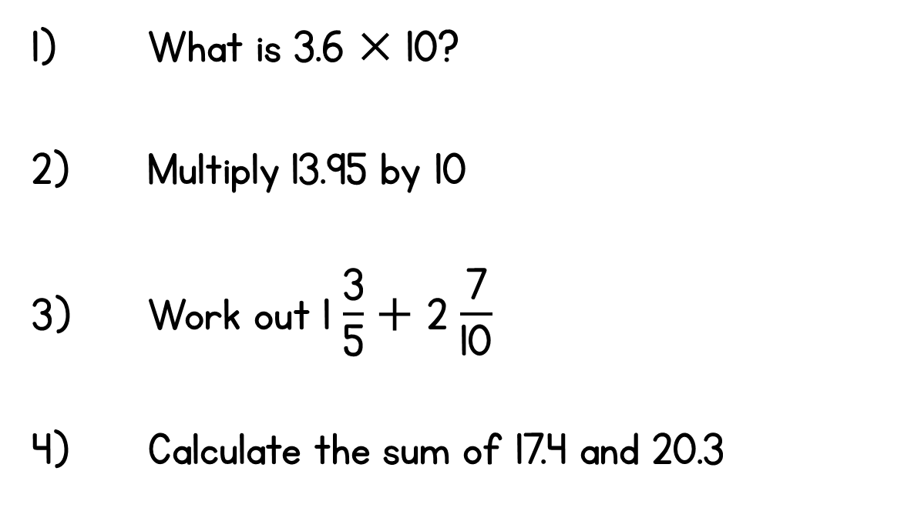
Year 6 | Week 1 | Day 4

Slide 5
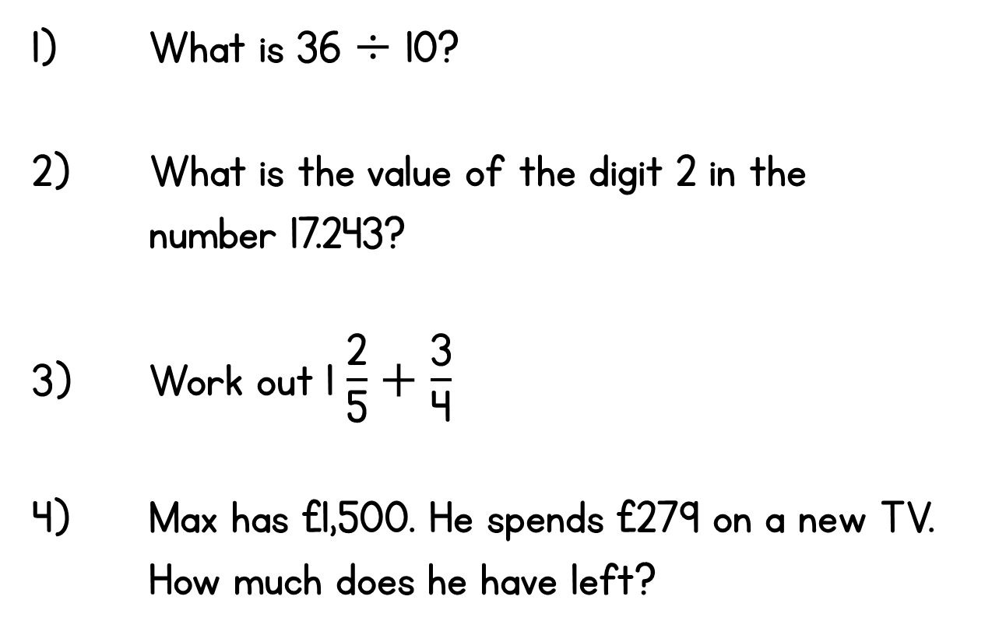
Year 6 | Week 1 | Day 5

Slide 6
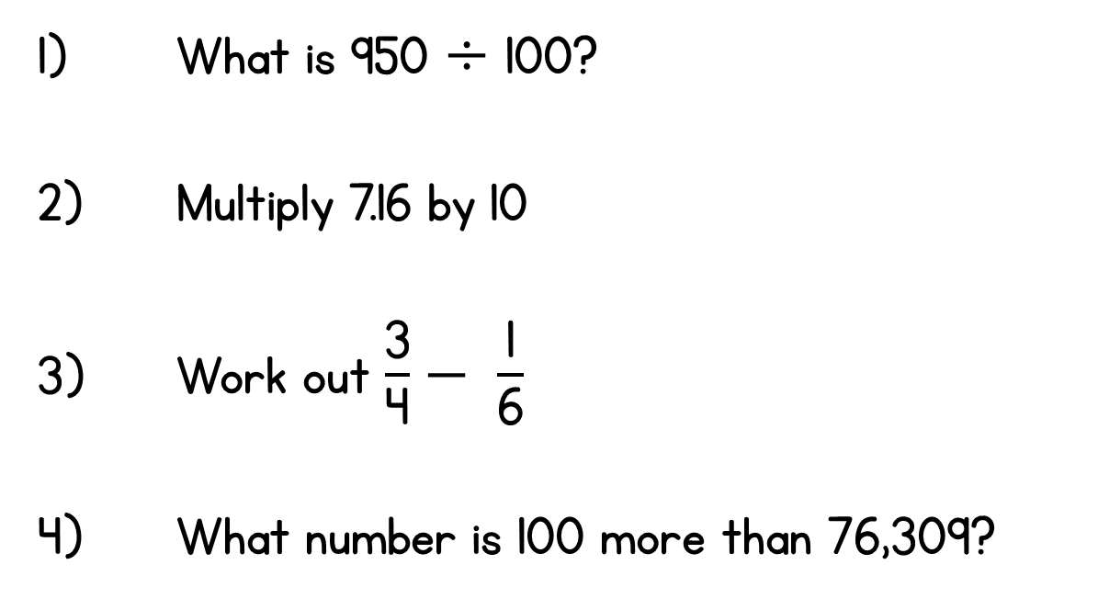
Year 6 | Week 2 | Day 1

Slide 7
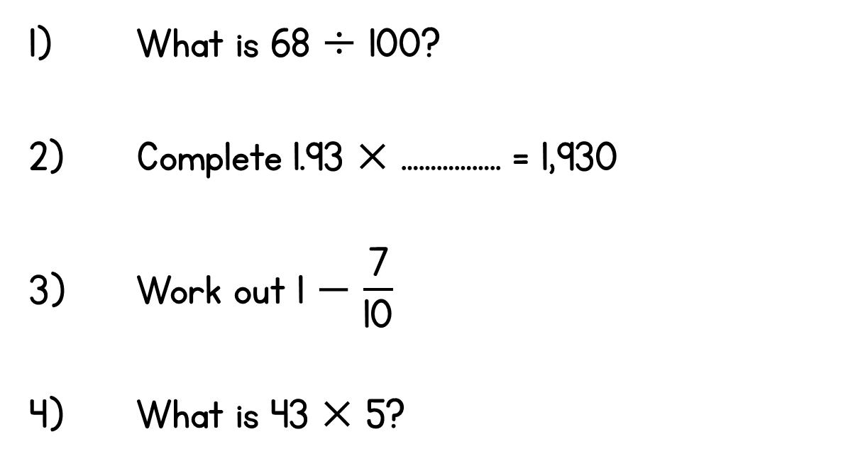
Year 6 | Week 2 | Day 2

Slide 8
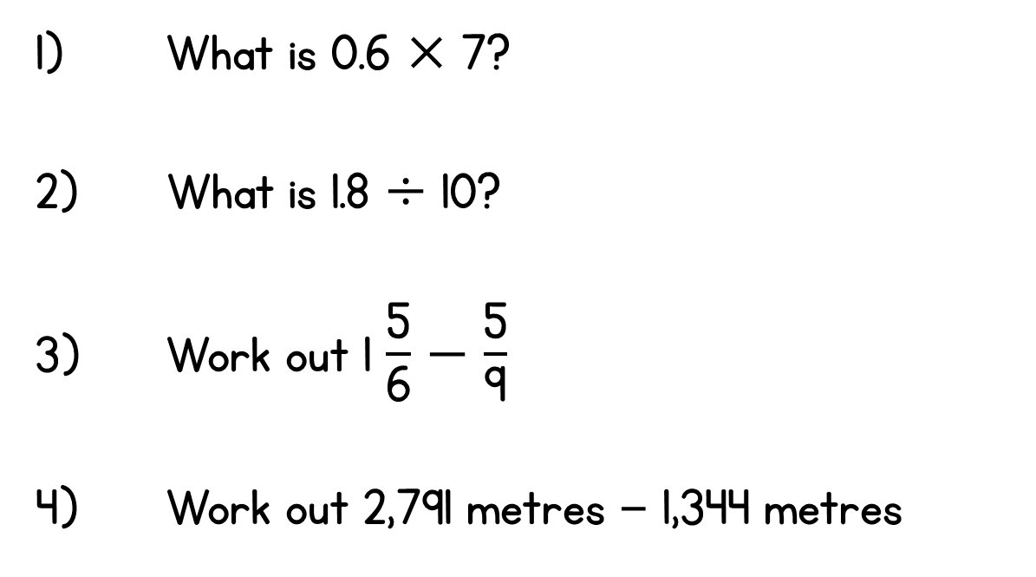
Year 6 | Week 2 | Day 3

Slide 9
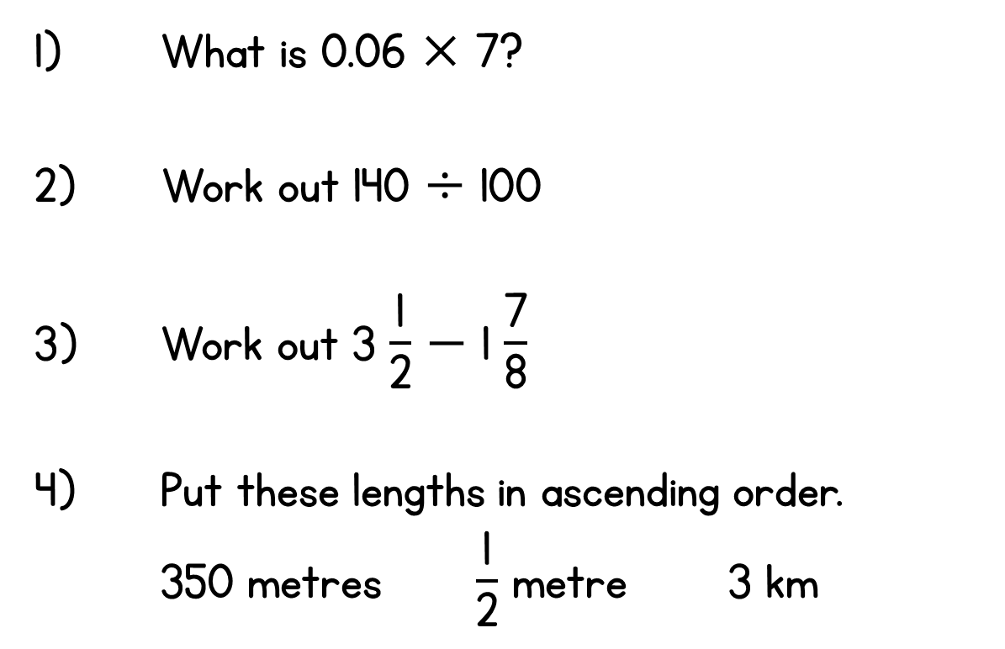
Year 6 | Week 2 | Day 4

Slide 10
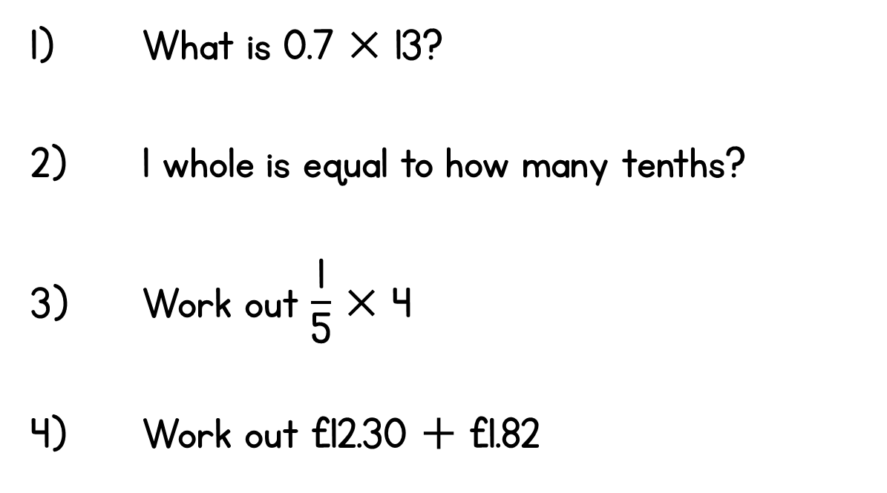
Year 6 | Week 2 | Day 5

