Slide 1
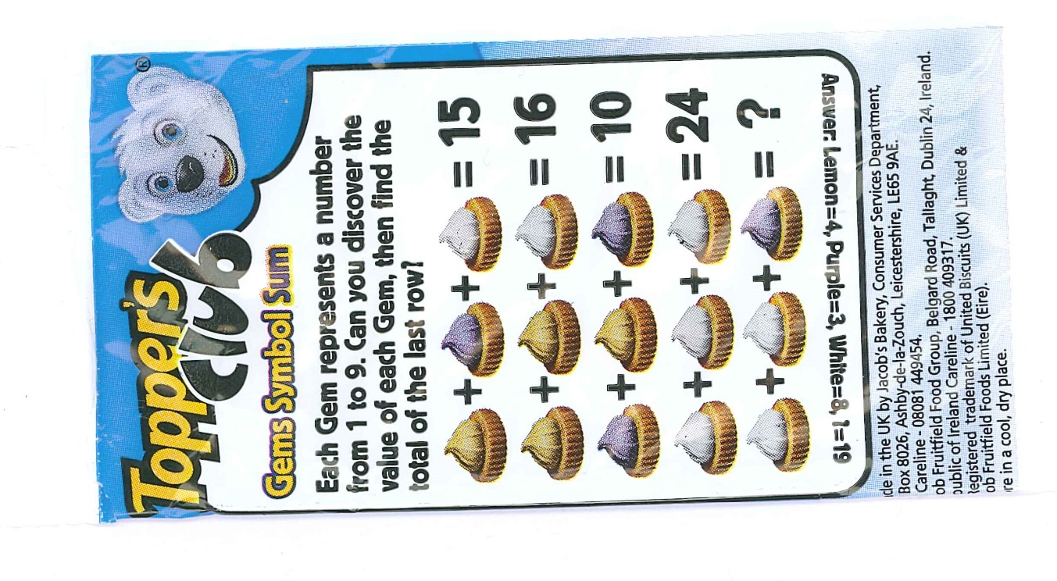

What’s the value of each shape?
Click on each sound button to hear the instructions.
In each puzzle, every shape is worth the same; so each triangle in puzzle one equals the same amount, each square the same amount and so on.
Find the missing numbers and write down the value of each of the shapes.
Here’s the catch. ..
I don’t just want to know how much each shape is worth: I also need to know which row or column you needed to do first before you could solve the puzzle.

Slide 2
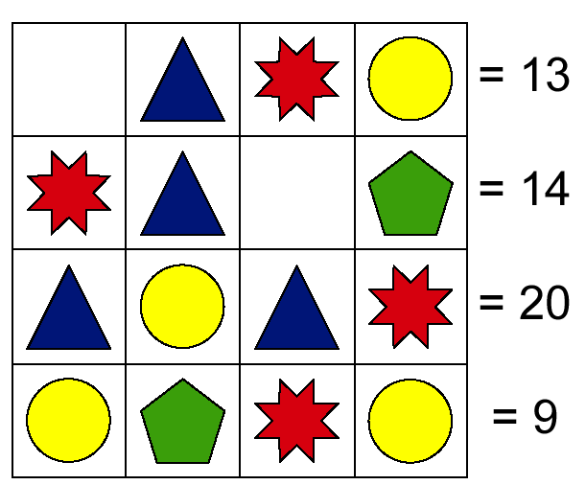
Use this space for jottings or jot onto paper.
= 13
= 12
= 20
= 9

Slide 3
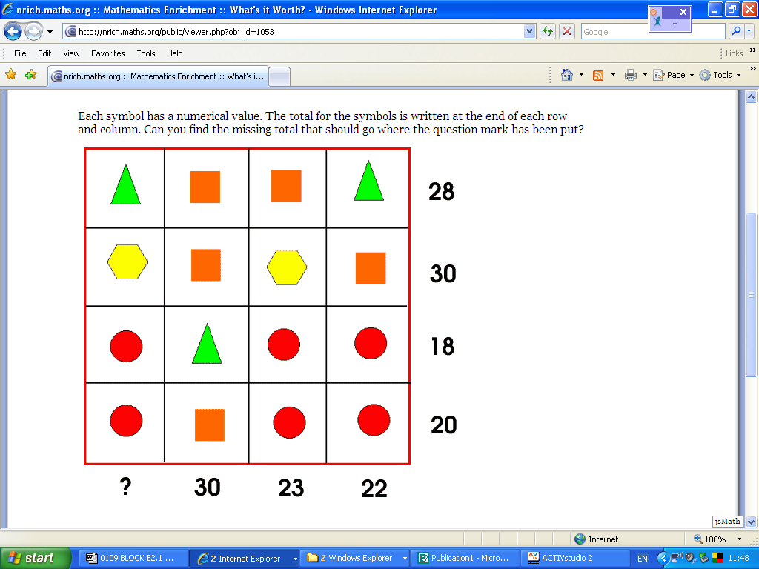

Slide 4
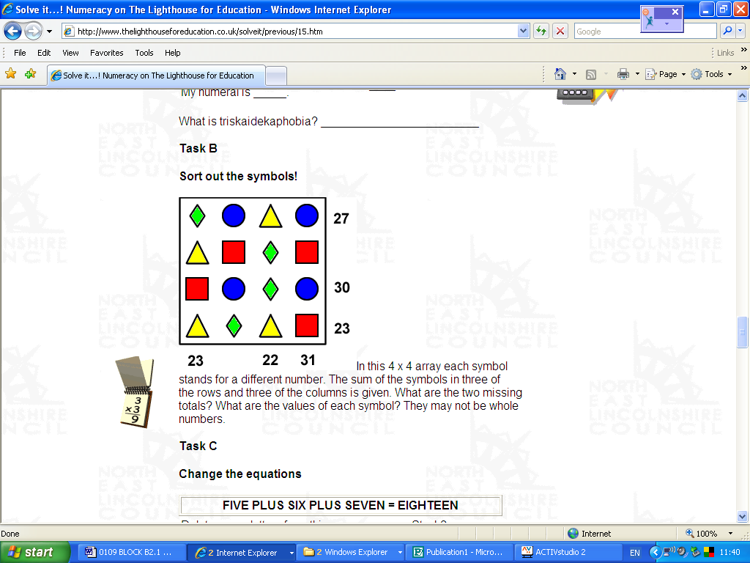
29
32
24
24 22 34

Slide 5

Supercharged Challenge!
This is not for the faint-hearted!
Create your own…
However, you MUST work out how to make it challenging. What is the lowest number of numbers that you need to add with the person still able to find an answer? This is harder than it sounds.
Does adding more shapes make you have to add more numbers to help? Does this make it easier?
Can you create one with only one way to break into the puzzle? This will make it harder for a friend to find out.
Is it possible to use decimals in your puzzles? Could you use numbers to two decimal places?

Slide 6

You do not need to have completed all of these. They don’t need handing in this week and can be something you keep coming back to for fun or in a spare moment.
I am happy to be asked questions or to receive one of your puzzles via teams for me to try to solve! This can be in any form, such as a photograph of your puzzle, a PowerPoint or a Word file.

