Slide 1
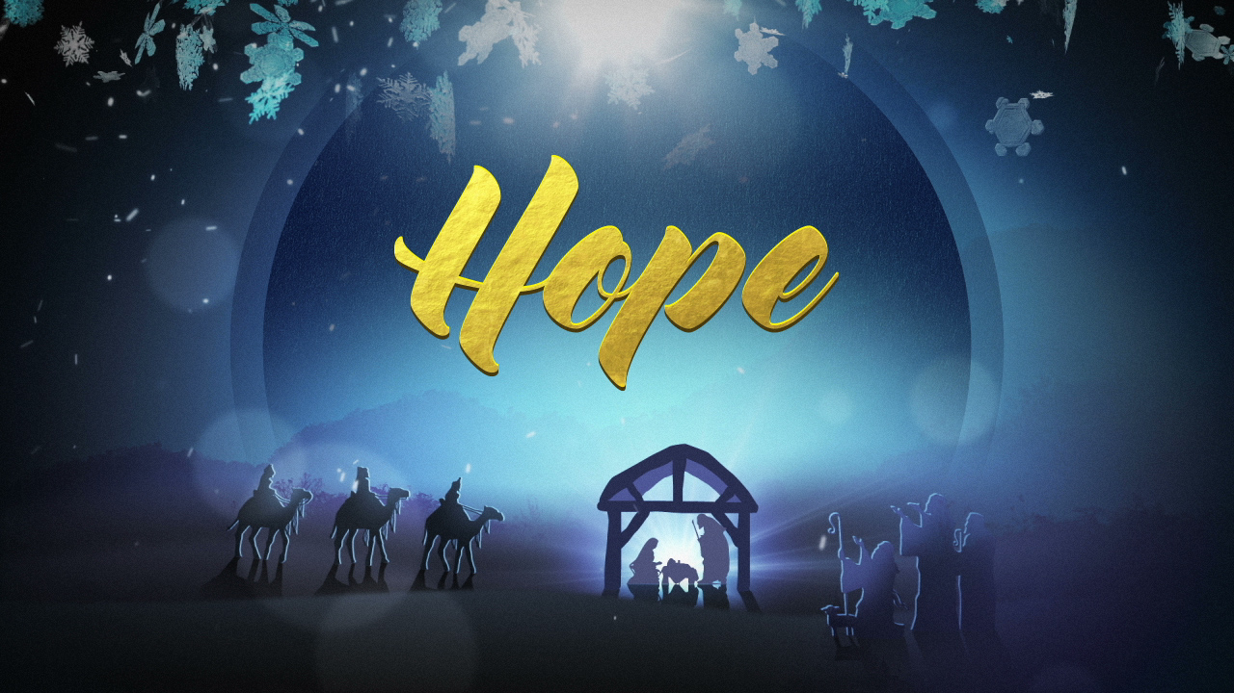

Slide 2


Step One - find out where are we heading?
You are going to write a piece of information for others to read about the problems faced in some communities because of global warming. It needs to:
  contain the facts needed for the reader to understand the issues
  encourage the reader to support those affected badly in ways such as, changing how we look after the planet and donating to a charity like Christian aid which set up projects to help
Completed writing will be used in the school newsletter and others will be sent to people like Father Graham to use in his Parish newsletter.
Today, you are going to make sure that you are prepared…

Slide 3


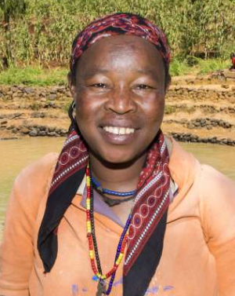
This week, you are ONLY going to check that you understand the issues and prepare notes ready for writing next week.
Task Two - Let’s get started. Make sure that you make useful notes and don’t just copy out big chunks of the texts.
You can listen to my notes about notes!
If you need a harder task, take my ten word challenge!

Slide 4
Task Three – Use the information using the links below and take notes about the problem and some of the ways in which solutions are found.
Information for you to take notes from
Christian Aid information page – click to read the information
Kawite’s story to show how global warming and changes in weather patterns are affecting communities – click to watch Kawite’s video. If the text goes too fast, don’t forget to pause it.
View the next page for some further information if you wish to add more examples to challenge yourself.
Notes:
https://www.christianaid.org.uk/appeals-key-appeals/christmas-appeal/christmas-stories-page
https://youtu.be/h50XZlMoX8w

Slide 5
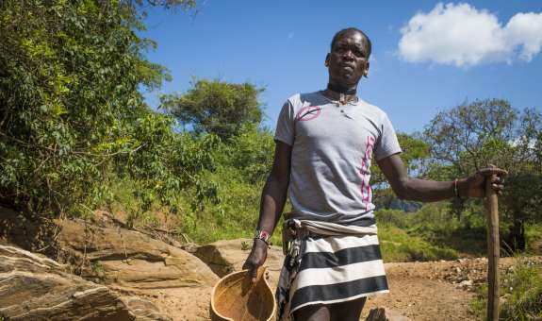
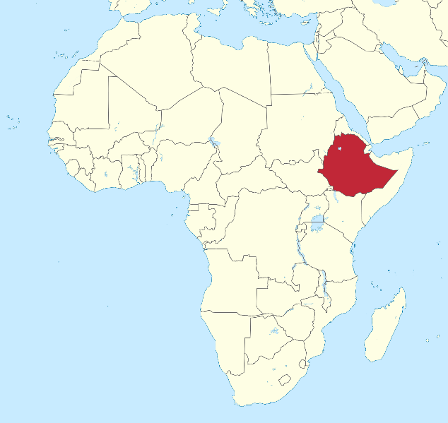
‘We pray for rain, but when there’s no rain, we have to dig.’
Mekonnon is a pastoralist living in Mukecha Kebele, in Ethiopia’s South Omo region in Africa, where the effects of climate change are very real. The rains have stopped, drought has dried the rivers, and crops no longer produce a harvest. Even the honey bees have disappeared.
The conditions are becoming unbearable.
Mekonnen knows his way of life as a pastoralist herdsman will not last much longer as the climate crisis worsens these conditions. Many of his livestock have already died, and hunger has forced him to sell off some of his remaining animals to feed his family.
Christian Aid partners are working with communities in this area, building more reliable water sources, providing drought resistant seeds to boost the harvest, and goats and sheep to help women build livelihoods.
But we need to tackle the causes of the changing climate, otherwise communities will continue to see their livelihoods threatened..
Africa
Pastoralist – someone who farms cattle or sheep

Slide 6

Please hand in your notes or a photo of your notes by the end of today via Teams. Your notes can be in Word, a photograph of your notes on paper or in a programme such as PowerPoint.

