Slide 1

Valuing our buddies
Time to video!

Slide 2
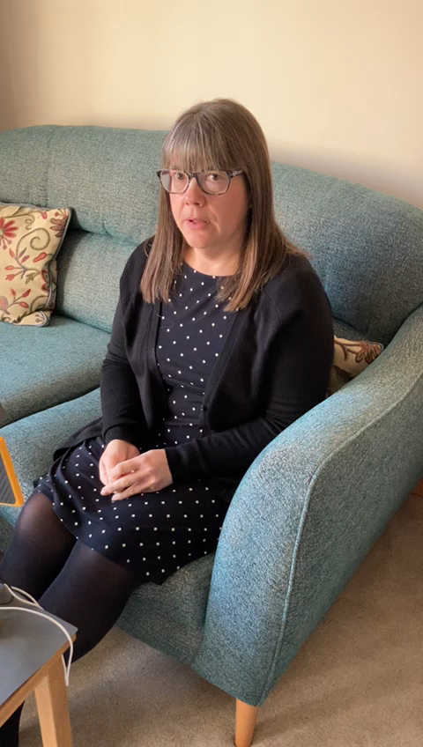
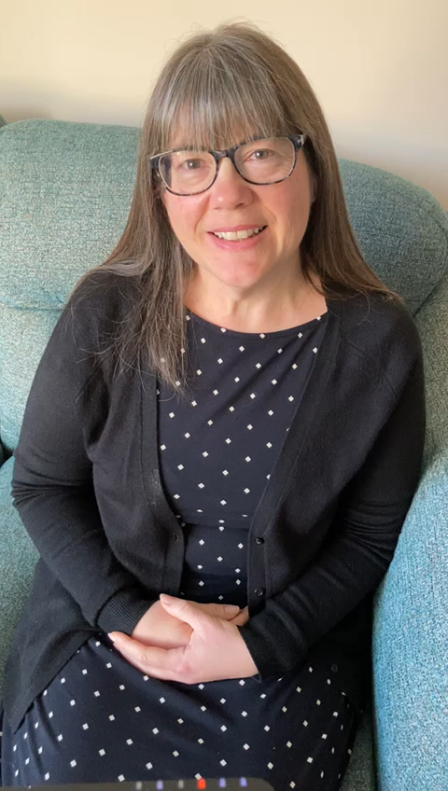
Can you improve the quality of your video?
Which one is the best video and why? I know that both need improvements. How will you ensure that your video is the best quality that you can make it? Remember, it does not have to be perfect! Practice looking confident and cheerful – hard to do when being videoed. I know that yours will be much better than mine!
Hello Reception and (name of buddy). Let us close our eyes and take some time to have a little think together. I have been thinking about how important kindness is. How can you be a kind friend? How can you be kind in the playground? [pause for a moment] How can you be kind in your class? [pause for a moment].
Let’s finish with a smile of kindness to each other. Lovely!
Please read the important points on the next page…

Slide 3

Time to Record
Please video your prayer or reflection from last week. Before you do this, please read the point below.
Make sure:
that you are in school uniform
that you make any changes that I asked you to make when I added your feedback last week
Improve your script if you need to. It is only a starting point.
that the background is as simple as you can get it. Please don’t record in your bedroom. It could be in the kitchen or in the garden.
that you practise in the mirror first to check that you are smiley and friendly.
watch your video back before you hand it in to check that the sound is loud enough and you are saying your words clearly for your buddies
You can hand your prayer or reflection in later in the week if you need to wait for someone to video this for you.
Notes:
https://berkswich-ce-vc-primary-school.primarysite.media/media/welcome-to-nursery-reception-at-berkswich-ce-prima

Slide 4

Please hand in your prayer or reflection video via Teams.
Remember that this can be handed in later in the week if needed.

