Slide 1


Slide 2
Step One – Read through your notes from last week
click to watch Kawite’s video to refresh your memory
These are excellent ones from Lucas:
Christian Aid helps change people’s lives.
Climate change is affecting the community’s traditional way of life.
Water started to decline in Kawite’s village, Ethiopia, caused by lack of rain.
Ponds dried out.
Not enough water for villagers and livestock.
Christian Aid helped Kawite and other villagers come together to build new pond, supplied materials and showed techniques
They now can grow crops, to make food grain; plant elephant grass to feed cattle, as now have water supply.

Slide 3

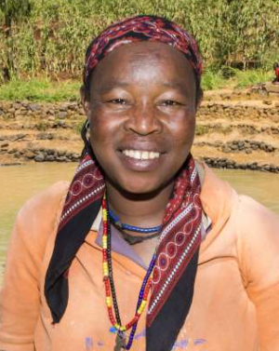
Write ten persuasive words or phrases to choose from. Write them on this page or in your notebook.
For example, you could use the word ‘just’.
Giving just five pounds can help to make all of the difference!
This make it feel like it would be so easy for you to give five pounds.
Step Two – Write ten persuasive phrases
Write your list of ten persuasive phrases. Remember, these include emotive words and phrases too. I’ve started your list off below.
just, you can make a difference, villages are struggling,

Slide 4
Step Three – Use your notes and persuasive phrases to write two paragraphs to persuade people to give money to Christian Aid’s Christmas Appeal.
Paragraph one
Write about Kawite or Mekonnon’s difficulties in Ethiopia. Knowing about individuals makes it easier for people to relate to and understand the problem. Write about how Christian Aid has helped the villagers to improve their own lives.
Paragraph two
Tell the reader what they can do to help. They will need to know how to donate. Think of a sentence to persuade to end with. Here are some examples.
Donate now to build hope for communities facing crisis this Christmas.
Give hope at Christmas – a small donation can bring big change.
Be a hope-bringer at this festive time. Care and click to donate now. ..
The link to the donation page can be found here: click to read the information
Notes:
https://www.christianaid.org.uk/appeals-key-appeals/christmas-appeal/christmas-stories-page
https://youtu.be/h50XZlMoX8w

Slide 5

Please hand in your paragraphs by the end of today via Teams. This can be in Word, a clear and close-up photograph of your notes on paper or in a programme such as PowerPoint.

