Slide 1

Comparing fractions without calculating
What strategies can you use?
Look to see if the denominators or numerators are the same. How does this help?
Compare to a half, a quarter, a third or another known fraction to help (these are called benchmarks)
See how far away they are from one whole or zero

Slide 2
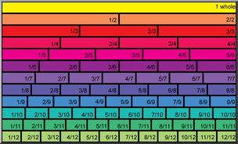
Use this to look at to help you out if needed.

Slide 3
1. Warm up - draw this out and add the fractions into the correct places, or drag each into the chart. Use the final page of the teaching notes to help if needed.
44
90
Less than one half | Equal to one half | Bigger than one half
5
12
9
17
35
70
13
24
8
17
17
34
89
150

Slide 4
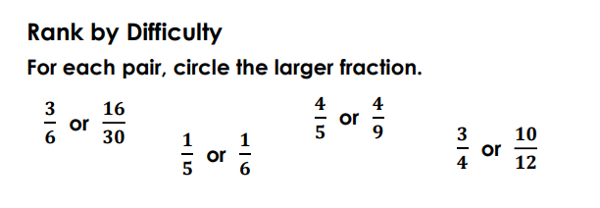
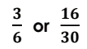
2. Circle the biggest fraction in each pair and then write an explanation to show how you knew which one was biggest. Use the strategies on the previous page to help out.

Slide 5
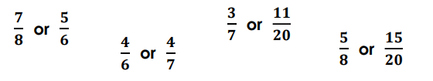
3. Circle the biggest fraction in each pair and then write an explanation to show how you knew which one was biggest. Use the strategies on the previous page to help out.

Slide 6
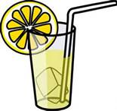
Extra challenge if needed. Read very carefully.
I mixed up some lemonade in two glasses.
The first glass had 200ml of lemon juice and 300ml of water.
The second glass had 100ml of lemon juice and 200ml of water.
Which mixture has the stronger tasting lemonade? How do you know? Can you prove it with fractions?

