Slide 1

Welcome to Monday 22nd November!
Maths – comparing fractions without calculations
Excel – part two looking at conditional formatting (miss this one out if there is no access to Excel)
Christian Aid Christmas Campaign – writing up notes from last week with persuasive features
Create a decoration for Dora Rose Nursing Home
Record your Buddy prayer or reflection (in uniform please)

Slide 2
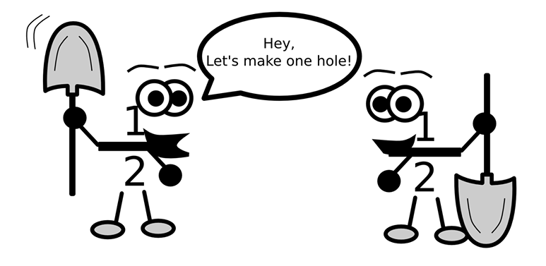
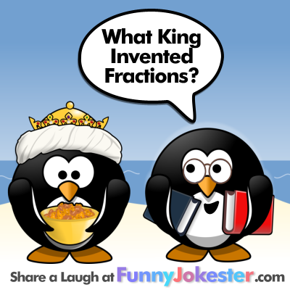
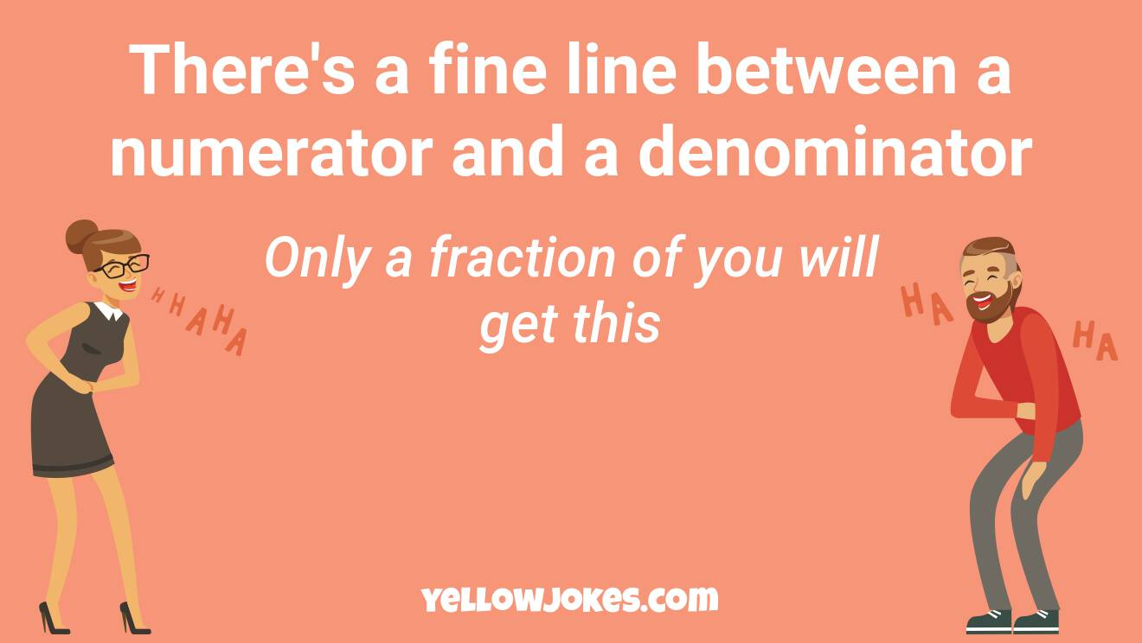
Let’s start
with some terrible fraction jokes
Henry the VIII

Slide 3


Comparing fractions

Slide 4
Comparing fractions
8
8
5
8

Slide 5
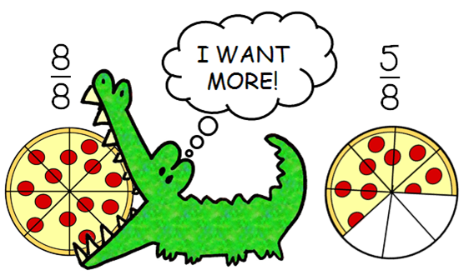

Slide 6
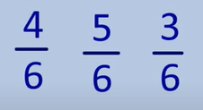


Slide 7
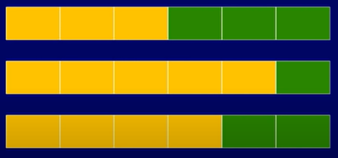

Slide 8
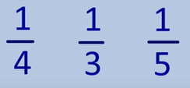
Different denominators

Slide 9
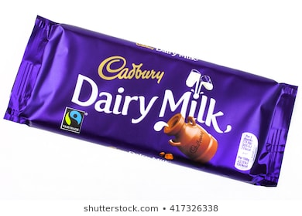

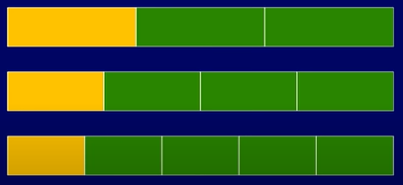

Slide 10

What happens when the numerators or denominators are different? Click to play!

Slide 11
Comparing fractions
How do you know?
5
8
7
16

Slide 12
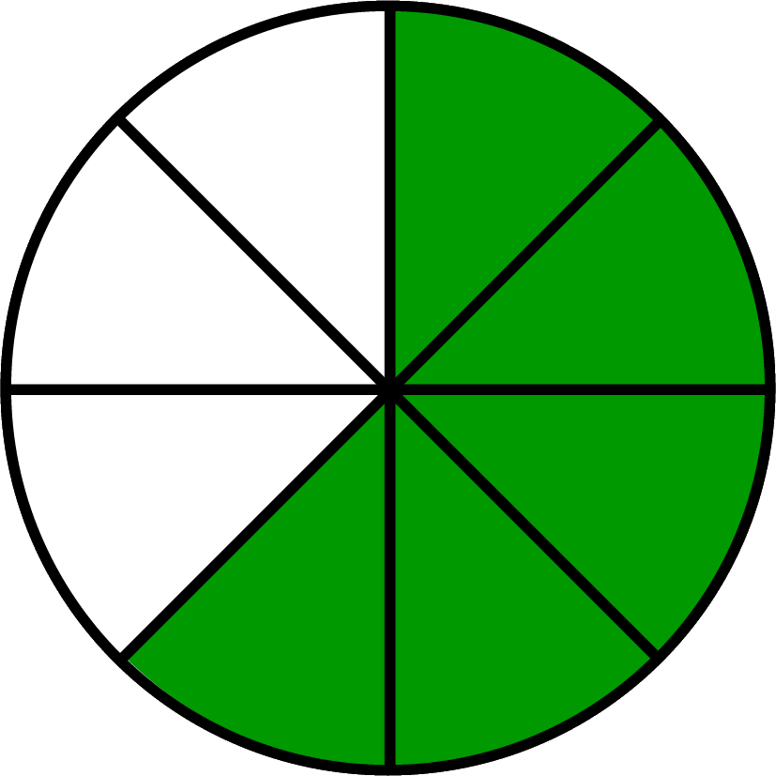
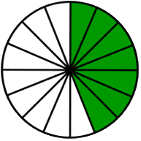
Which of these two is the biggest?
5
8
7
16

Slide 13
What would be a half of each one?
5
12
9
16

Slide 14
What would be a half of each one?
5
12
9
16
6
12
8
16

Slide 15
Is it possible to find how many 11ths or how many 13ths are equivalent to a half?
5
11
7
13

Slide 16
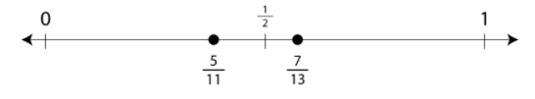

Slide 17
Another way…
10
11
12
13

Slide 18
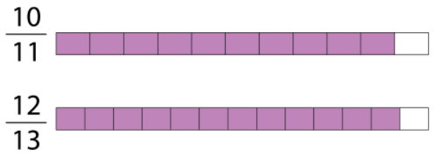
Comparing fractions
Which has the biggest part missing?

Slide 19
Comparing fractions without calculating
What strategies can you use?
Look to see if the denominators or numerators are the same. How does this help?
Compare to a half, a quarter, a third or another known fraction to help (these are called benchmarks)
See how far away they are from one whole or zero

Slide 20
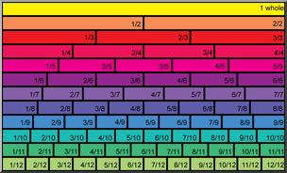
Use this to look at to help you out if needed.

Slide 21
1. Warm up - draw this out and add the fractions into the correct places, or drag each into the chart. Use the final page of the teaching notes to help if needed.
44
90
Less than one half | Equal to one half | Bigger than one half
5
12
9
17
35
70
13
24
8
17
17
34
89
150

Slide 22
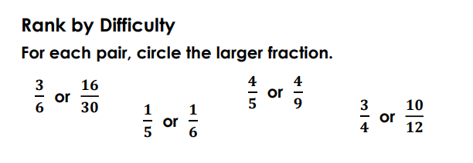
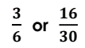
2. Circle one fraction in each pair and then write an explanation to show how you knew which one was biggest. Use the strategies on page one to help out.

Slide 23
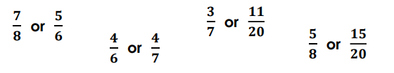
3. Circle one fraction in each pair and then write an explanation to show how you knew which one was biggest. Use the strategies on page one to help out.

Slide 24

Extra challenge if needed. Read very carefully.
I mixed up some lemonade in two glasses.
The first glass had 200ml of lemon juice and 300ml of water.
The second glass had 100ml of lemon juice and 200ml of water.
Which mixture has the stronger tasting lemonade? How do you know? Can you prove it with fractions?

