Slide 1
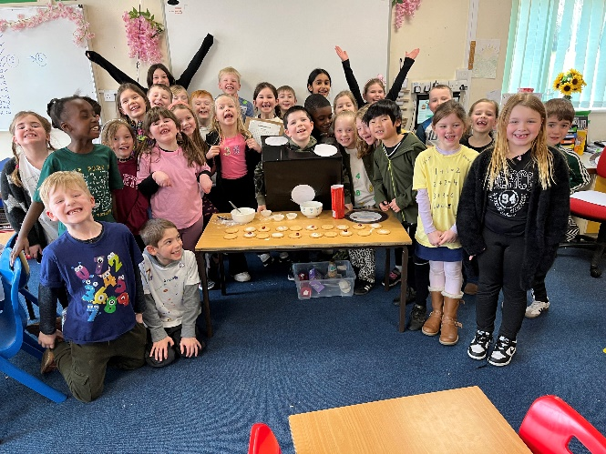
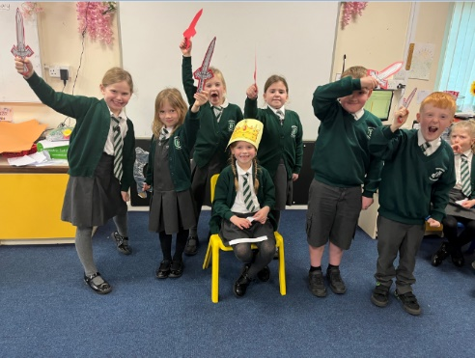
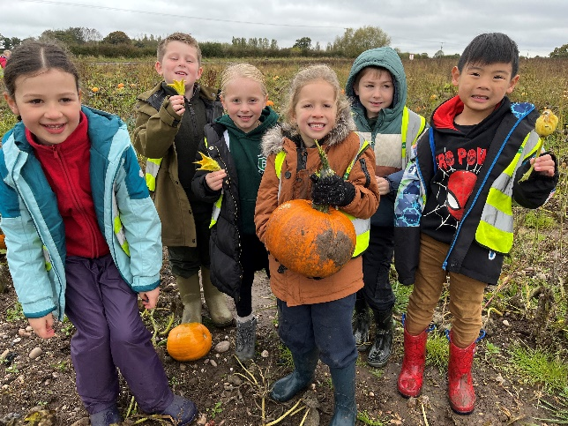
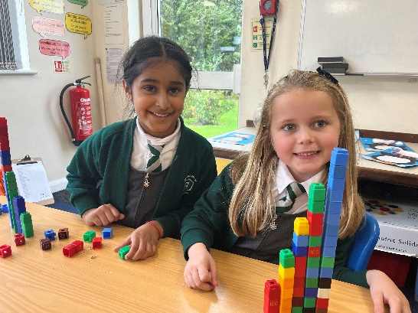
Key Stage One Non-Statutory Assessment
2025

Slide 2
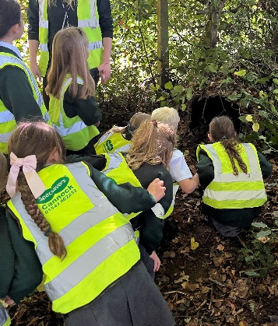
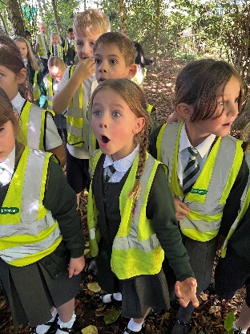
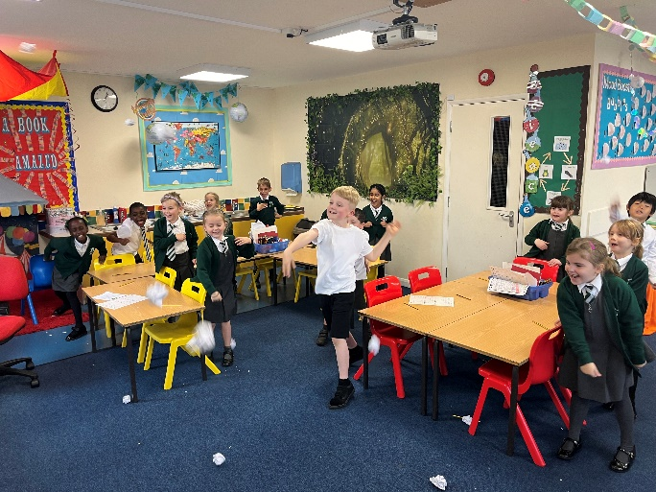
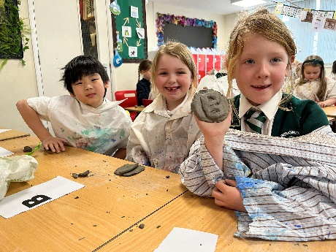
What are SATs?
At the end of Year 2 and Year 6, children in England sit standardised assessment tests to check their educational progress. SATs give teachers the chance to see how children are doing nationally.
English – Reading Paper 1 and Paper 2
English – Grammar, Punctuation & Spelling
Mathematics – Arithmetic & Reasoning

Slide 3
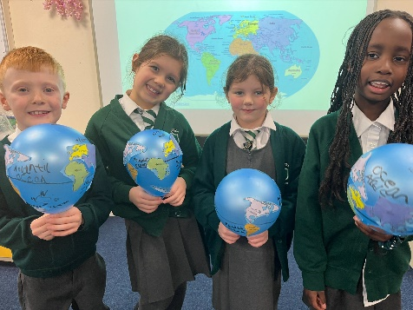
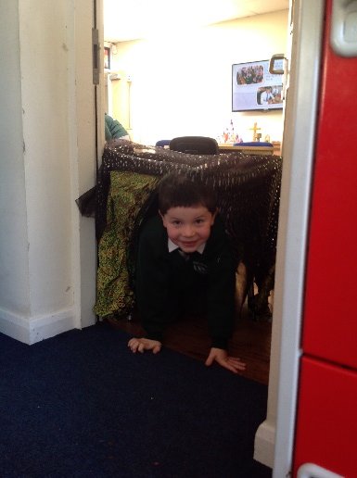
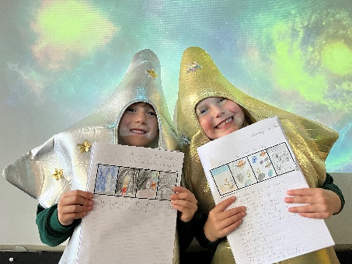
What are SATs?
KS1 SATs have become optional from September 2023. However, the Department of Education (DfE) will continue to provide standardised tests at the end of Year Two that may be taken by children in the Summer Term. This is because Year Two is the last year group in Key Stage One.
Along with many schools, we have decided to take part in the optional tests; these help to support teacher assessment, but do not replace it.

Slide 4

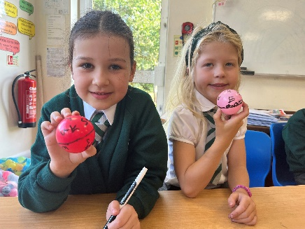
Assessment
Non-statutory assessments help to build a picture of your child’s learning and achievements along with their daily classroom learning in order to assess them at Age Related Expectations at the end of Year Two.
As in recent years, writing will be teacher assessed internally and moderated in the year group. We also work with local schools and take part in moderation sessions (Reception to Year Six), to ensure that our assessments are accurate and quality-assured.
It is vital that the children are excited by learning and see each day as a new opportunity to improve. It is our experience that children demonstrate their best abilities when relaxed and happy; therefore, we do not refer to these assessments as 'tests' or speak about them in a way that could increase stress and worry.

Slide 5
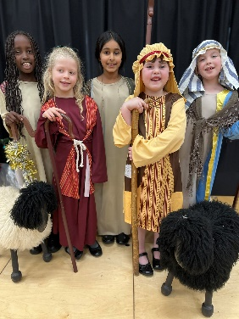
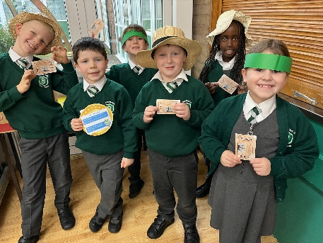
What are SATs?
The papers themselves, whilst being designed to test children’s knowledge, will consist of questions that are similar to the ones children would have seen in class or in their end of term assessments.
There is no set date to complete the tests by, but they will take place in May. The papers will be marked in school by Mrs Rae.
It is the ethos of the school that we do not over-test; instead, we provide lively and engaging opportunities to maximise learning within meaningful contexts. Nearer the time, Mrs Rae will work with the children to have a go at past papers. We ask parents not to use the government's draft or previous papers, since these may be used in school before May.

Slide 6
Overview of test papers
Reading Paper 1 and 2 – A selection fiction, non-fiction and poetry texts. They consist of a combined reading prompt and answer booklet. The tests takes approximately 30 minutes. Paper 2 contains more challenging texts.
Maths Paper 1 – (Arithmetic) It takes approximately 20 minutes.
Maths Paper 2 – (Reasoning) It takes approximately 35 minutes.
Grammar, Spelling and Punctuation Paper 1 – A 20 word spelling test. The paper takes approximately 15 minutes.
Grammar, Spelling and Punctuation Paper 2 - The paper takes approximately 20 minutes.

Slide 7
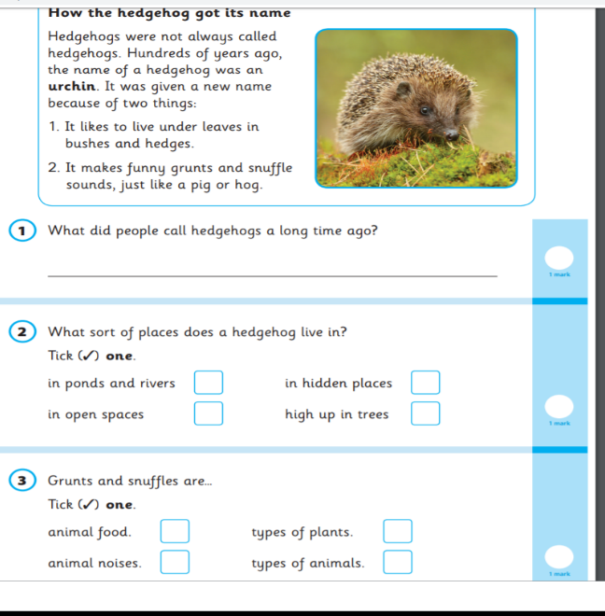
Reading Paper 1 Example

Slide 8

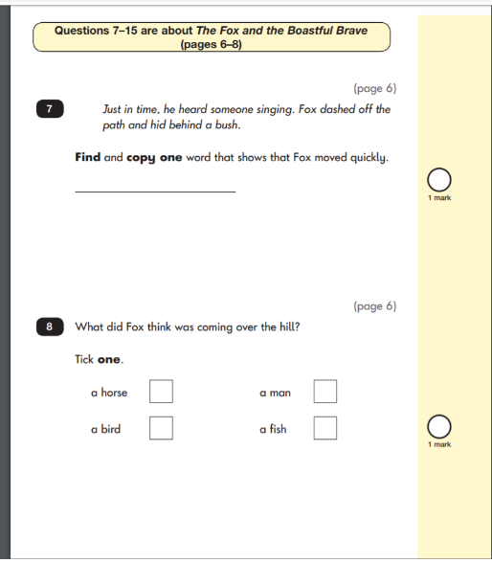

Reading Paper 2 Example

Slide 9
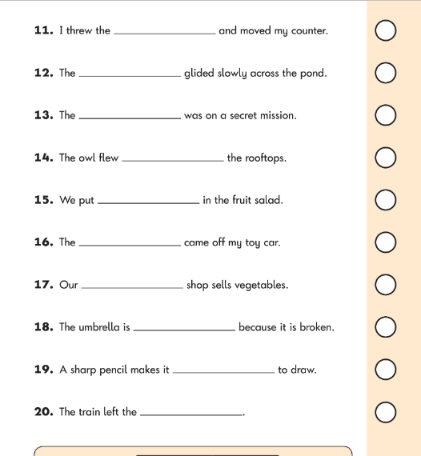
Spelling Example

Slide 10
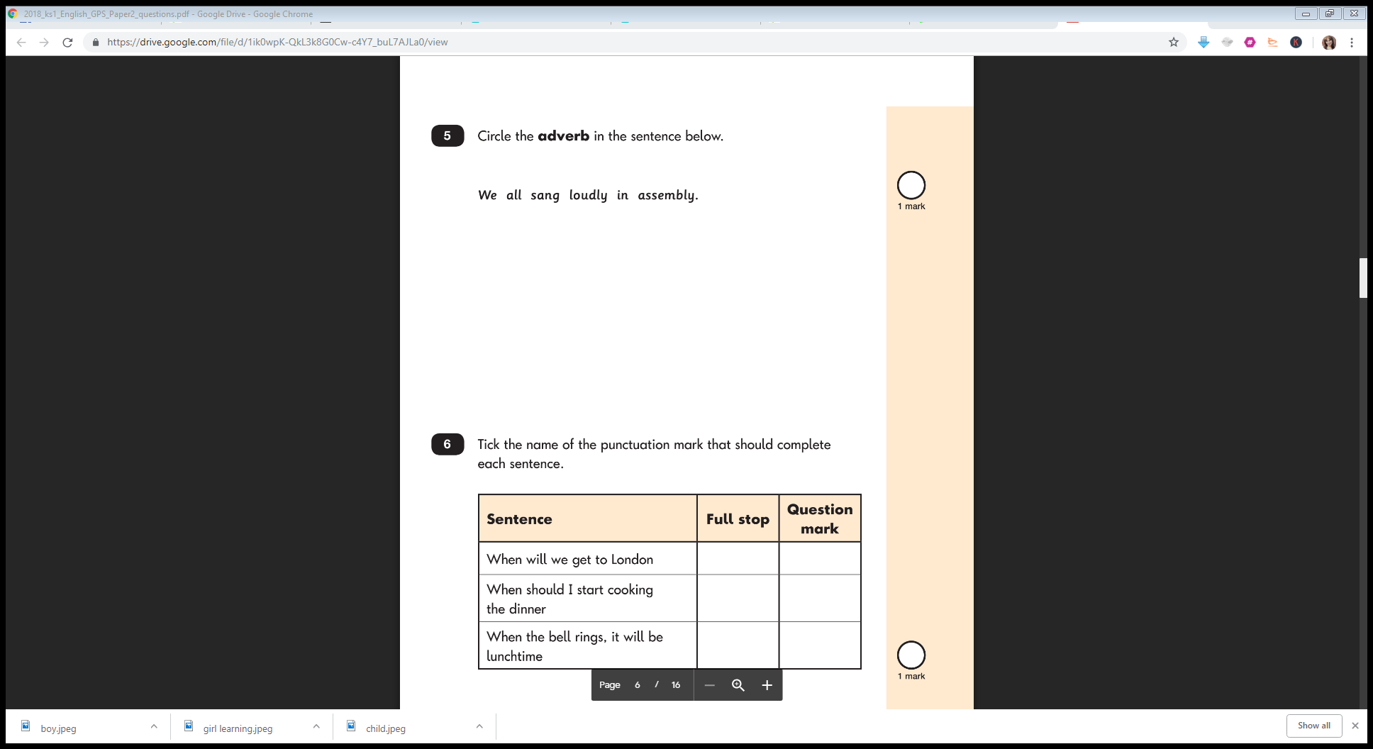
Grammar Example

Slide 11
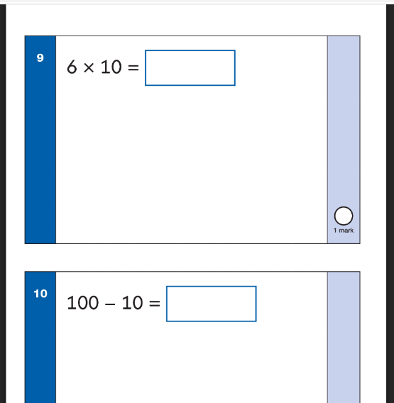
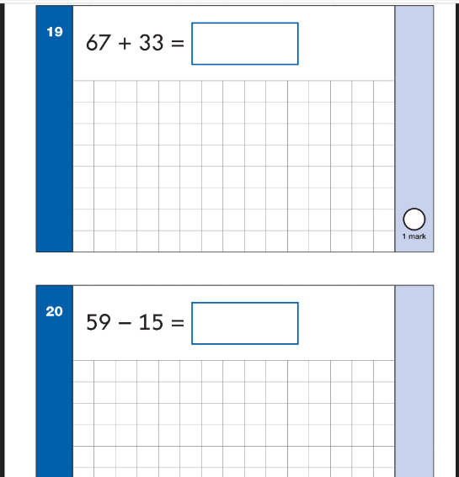
Maths Paper 1 (Arithmetic) Example

Slide 12
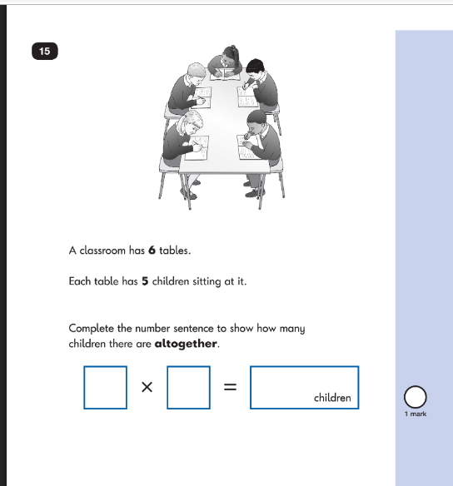
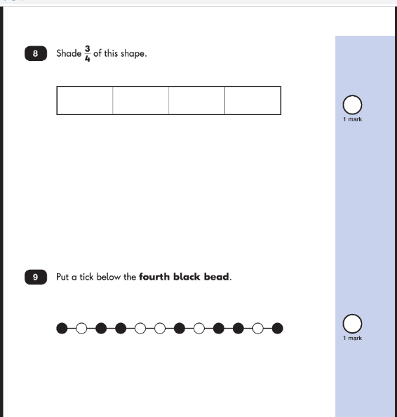
Maths Paper 2 (Reasoning) Example

Slide 13
How can you help at home?
First and foremost, support and reassure your child that there is nothing to worry about and they should try their best.
Help your child with reading: listen to them read often and focus on bringing out a ‘love of reading’. Reading stories to your child allows them to develop language, listening skills and comprehension. Encourage making predictions of what might happen next and check their understanding of what they have read.
Help your child with writing by supporting with weekly spellings. Write together to make shopping lists and letter writing.
Help your child with maths by playing times table games, practicing number bonds and doing simple addition and subtraction sums. Work out what time it is together. Provide opportunities for your child to pay for things in a shop, to work out how much things cost and how much change will be needed. Counting forwards and backwards in 2s, 5s and 10s.

Slide 14
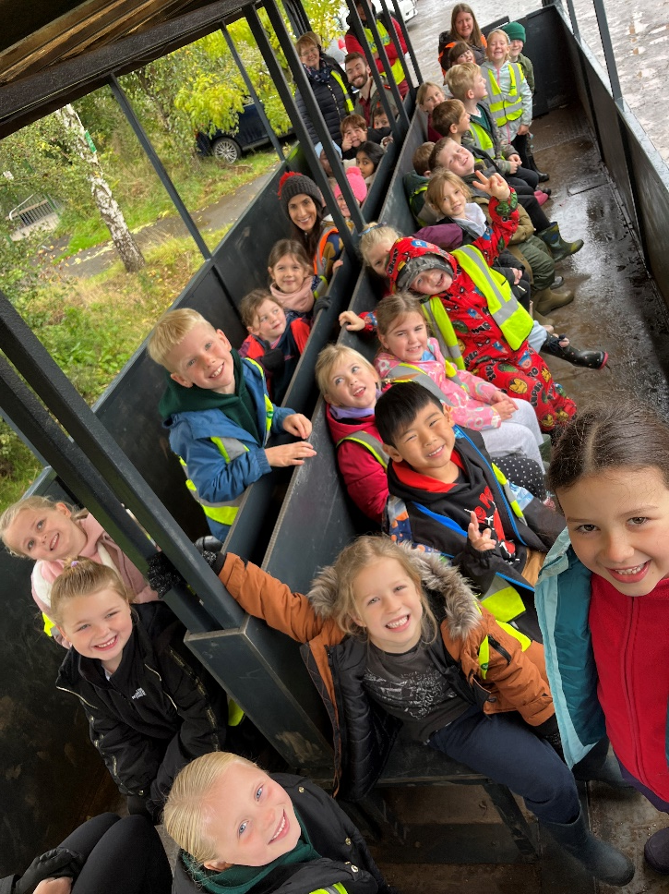
Please remember that the non-statutory assessments are just a snapshot of learning and that we will continue to learn with eagerness, developing the whole child and inspiring their imaginations in Year Two throughout the Summer Term and into Year Three.

Slide 15
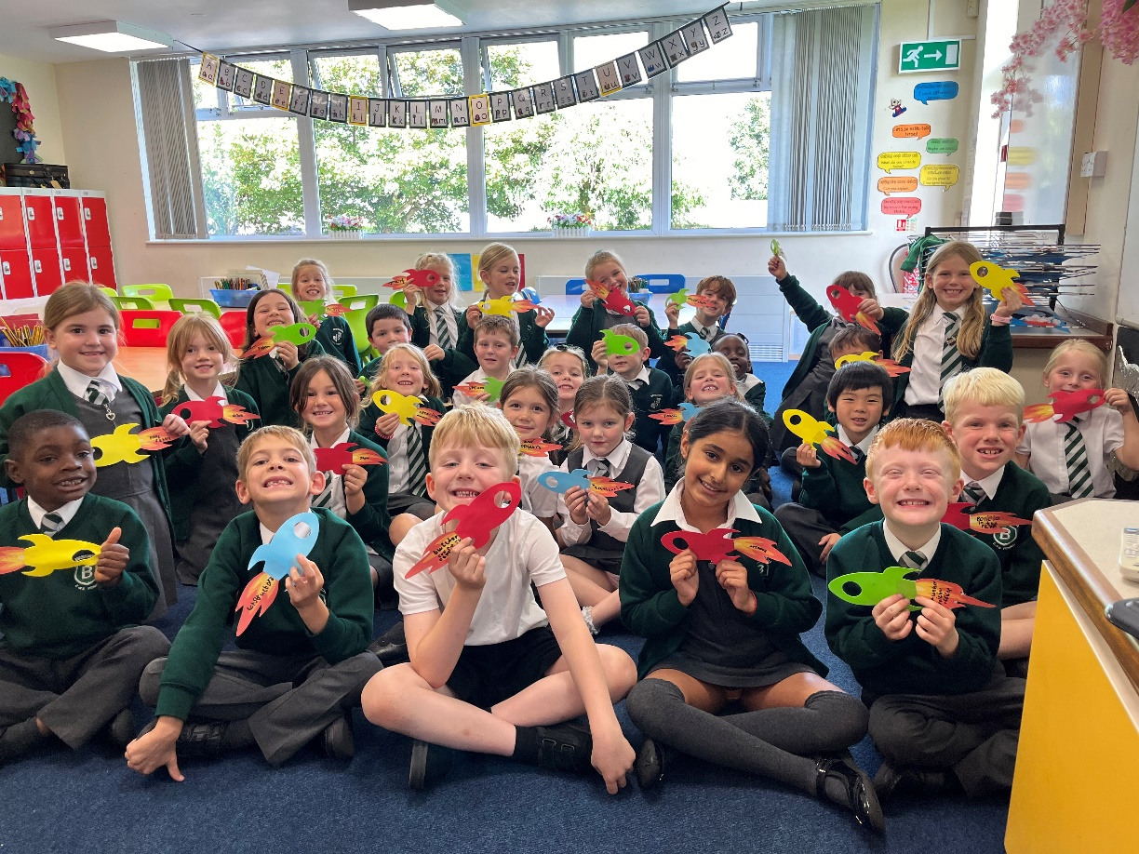
Any Questions?

