Slide 1

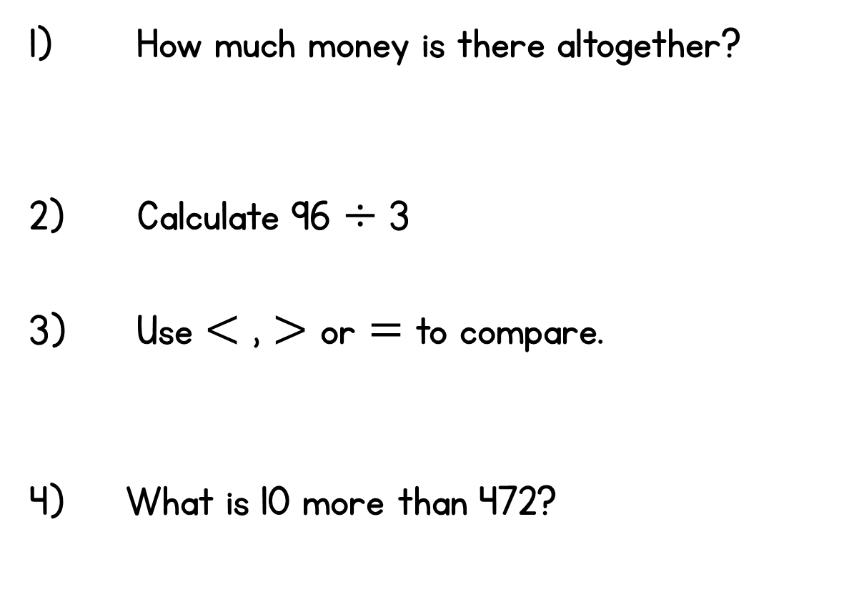









Year 3 | Week 4 | Day 1

Slide 2
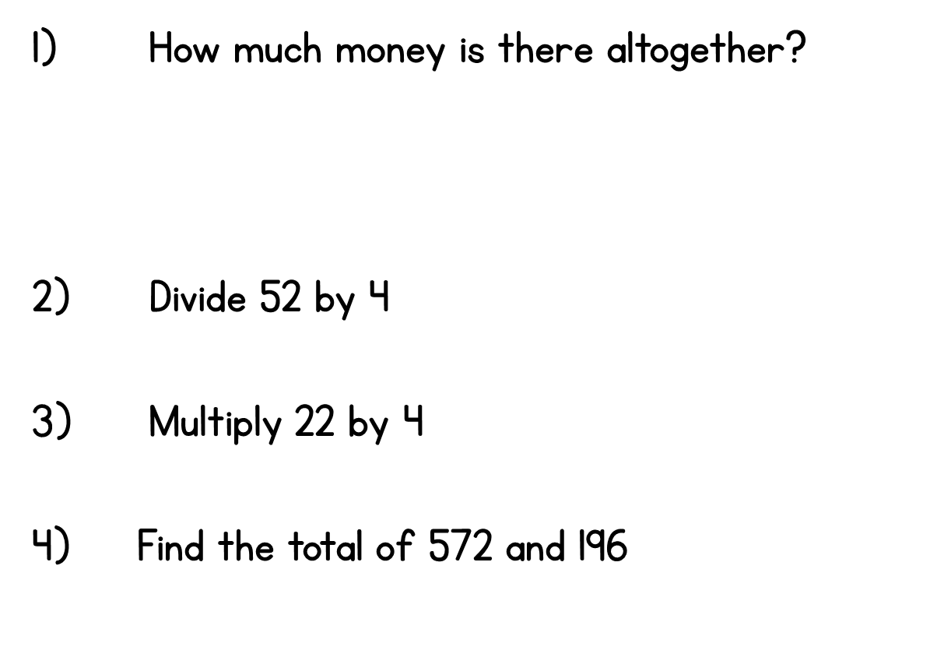
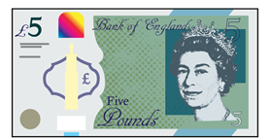







Year 3 | Week 4 | Day 2

Slide 3
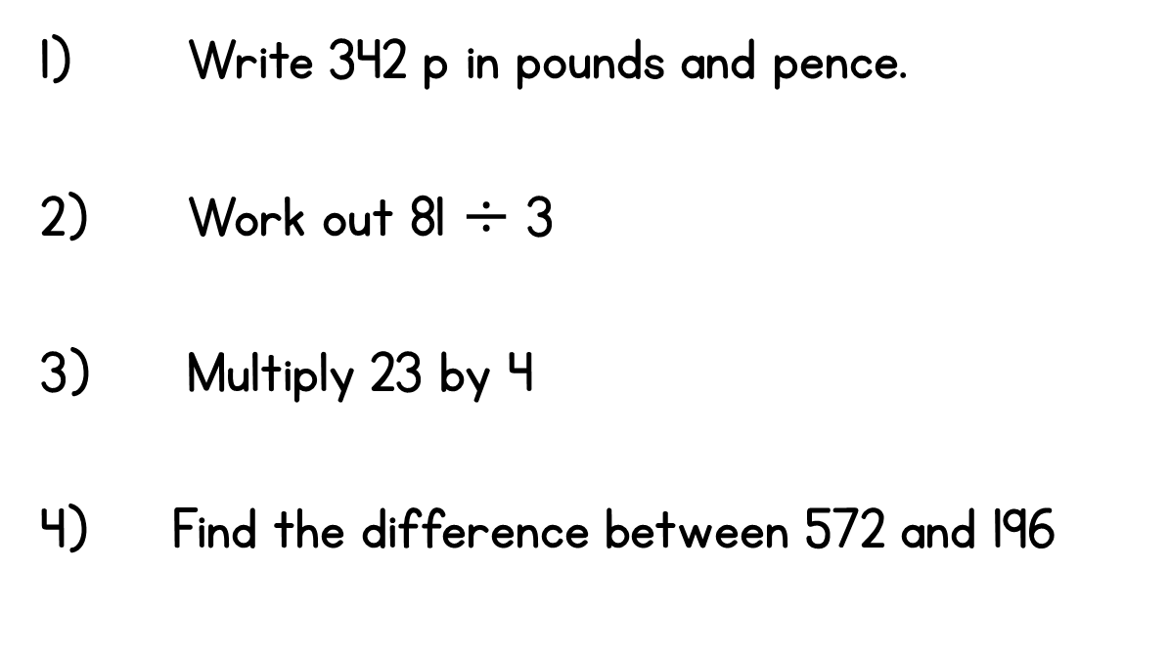




Year 3 | Week 4 | Day 3

Slide 4
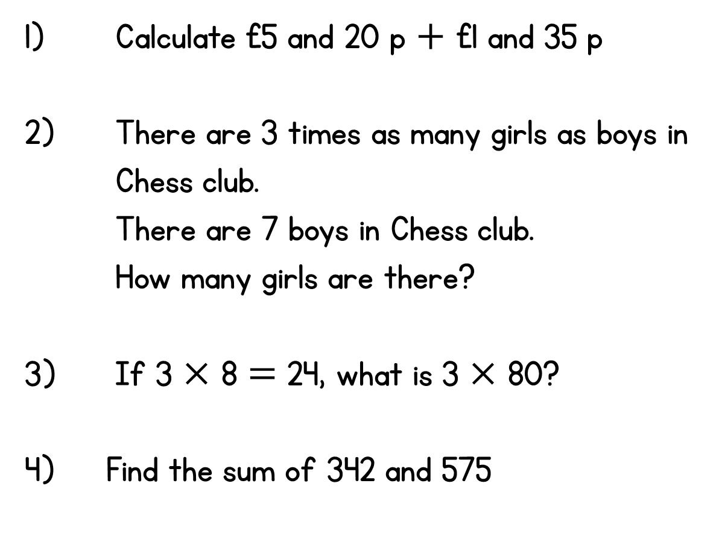




Year 3 | Week 4 | Day 4

Slide 5
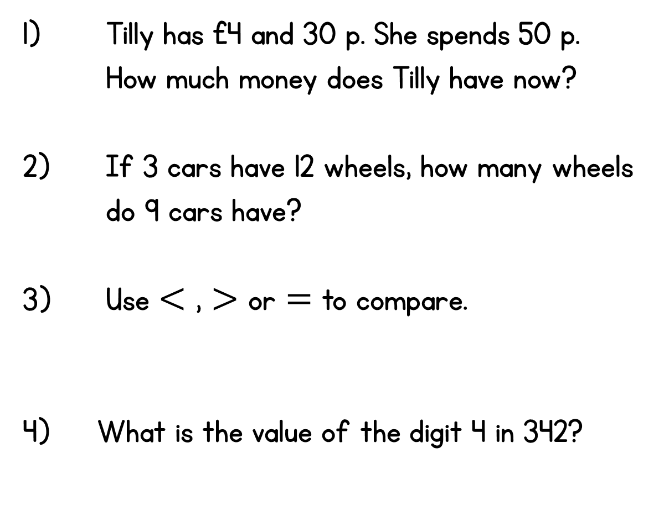






Year 3 | Week 4 | Day 5

