Slide 1

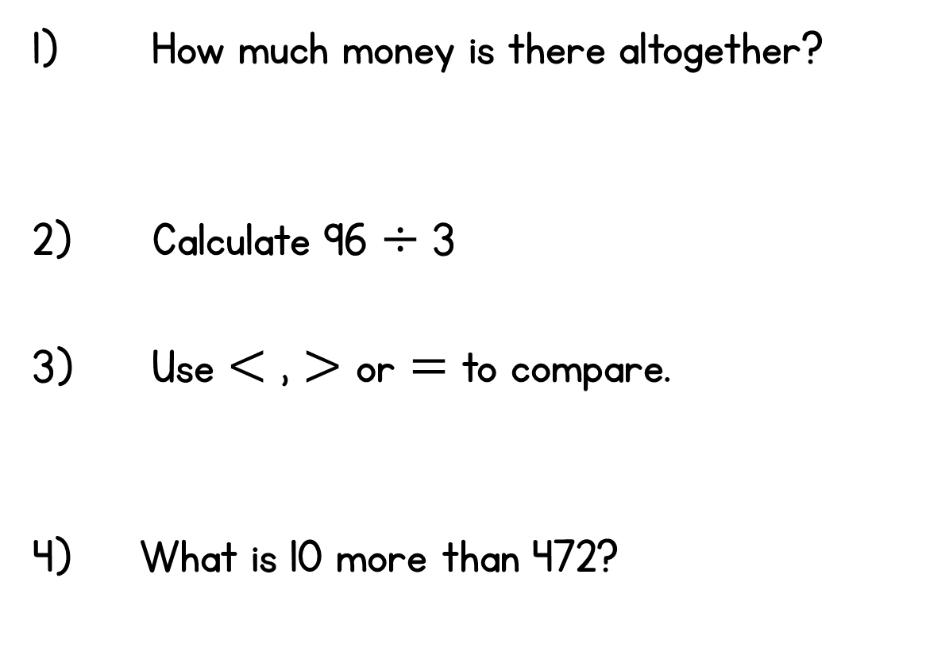





Year 3 | Week 4 | Day 1

Slide 2
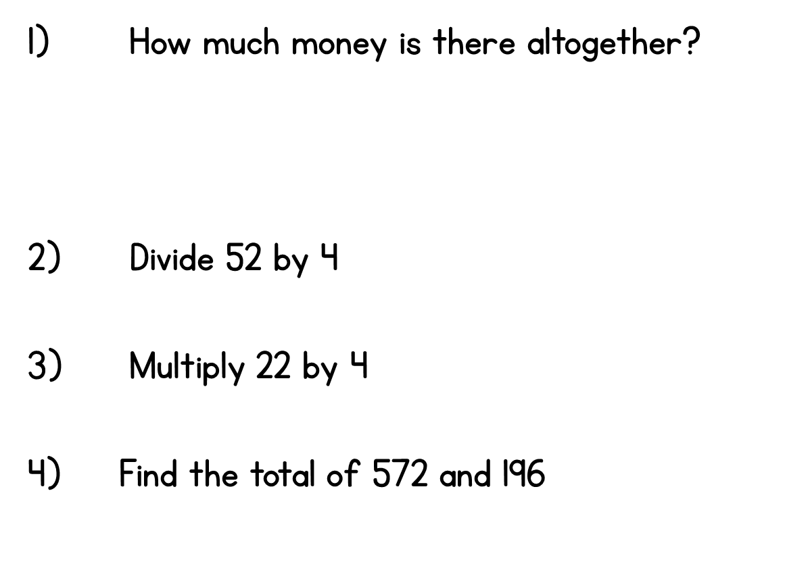
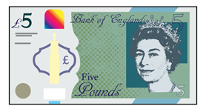



Year 3 | Week 4 | Day 2

Slide 3
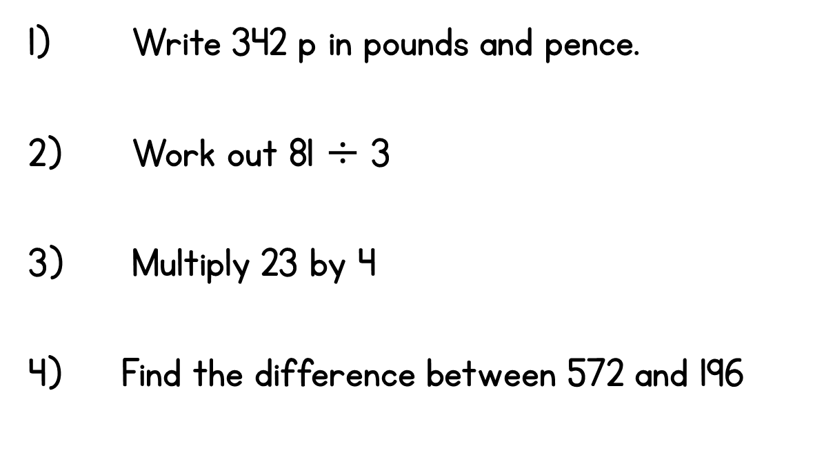
Year 3 | Week 4 | Day 3

Slide 4
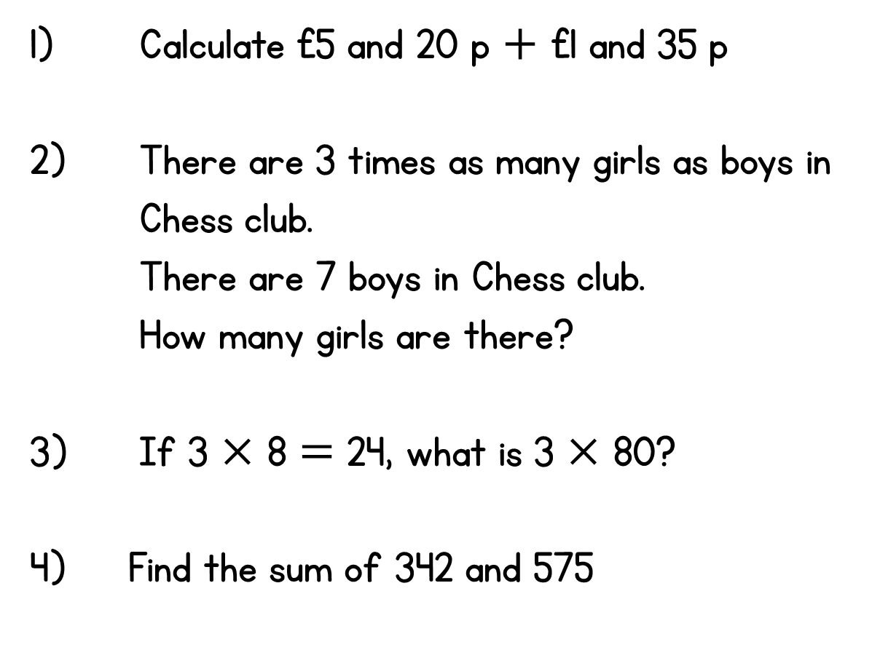
Year 3 | Week 4 | Day 4

Slide 5
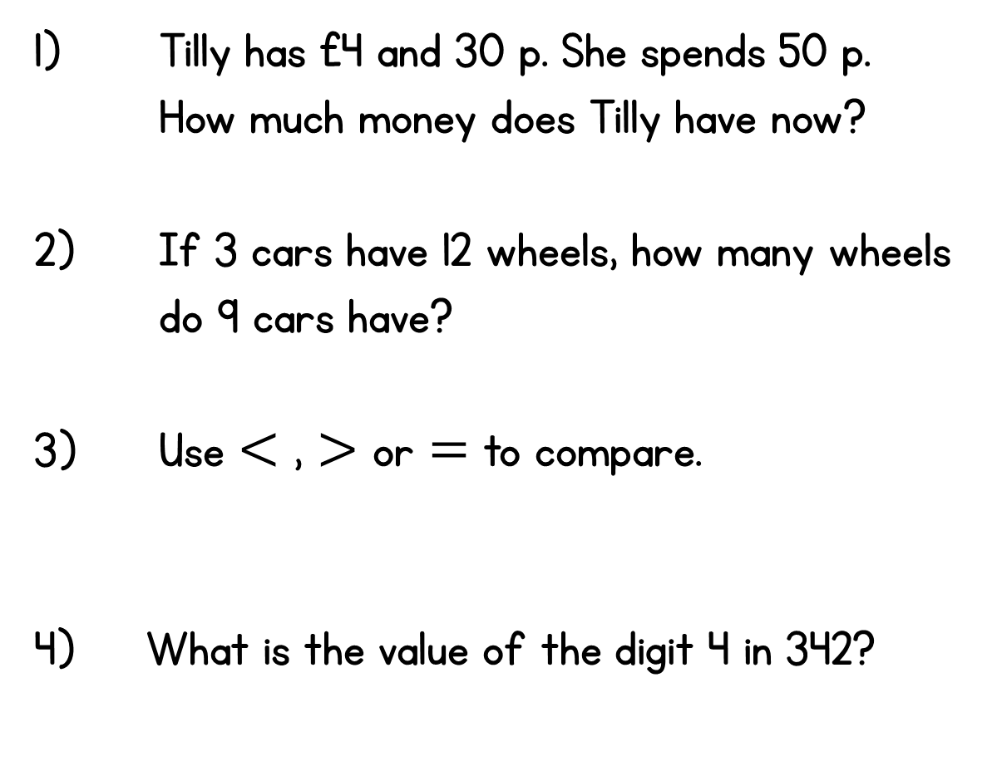


Year 3 | Week 4 | Day 5

