Slide 1

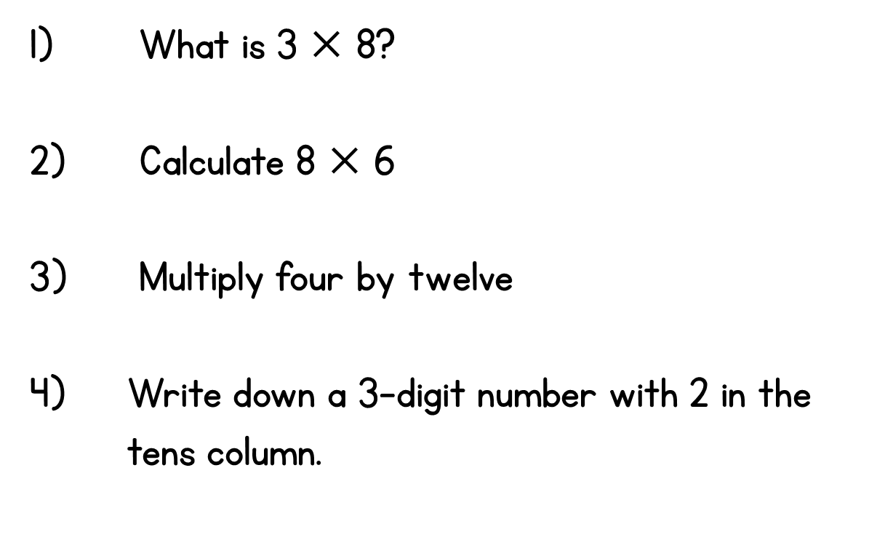
Year 3 | Week 1 | Day 1

Slide 2
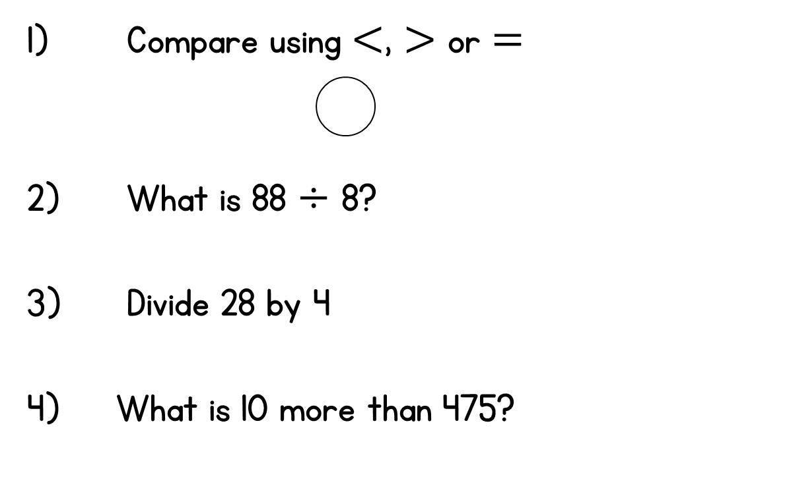
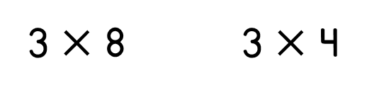
Year 3 | Week 1 | Day 2

Slide 3
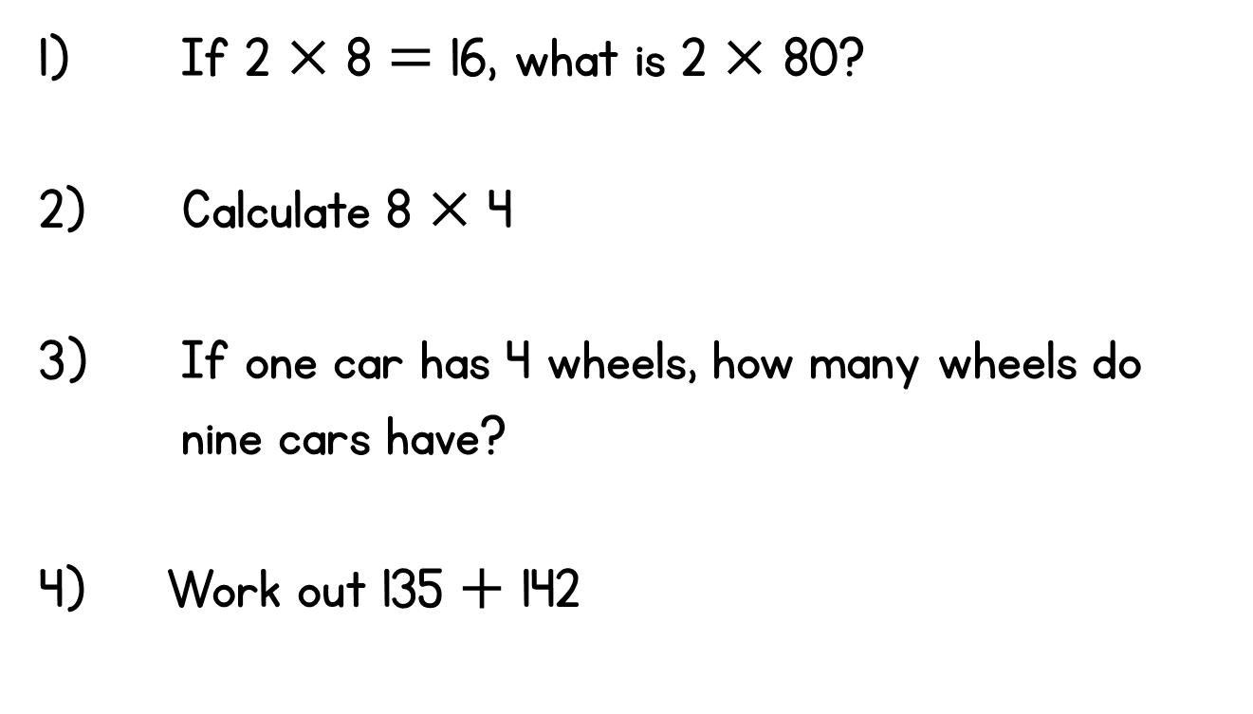
Year 3 | Week 1 | Day 3

Slide 4
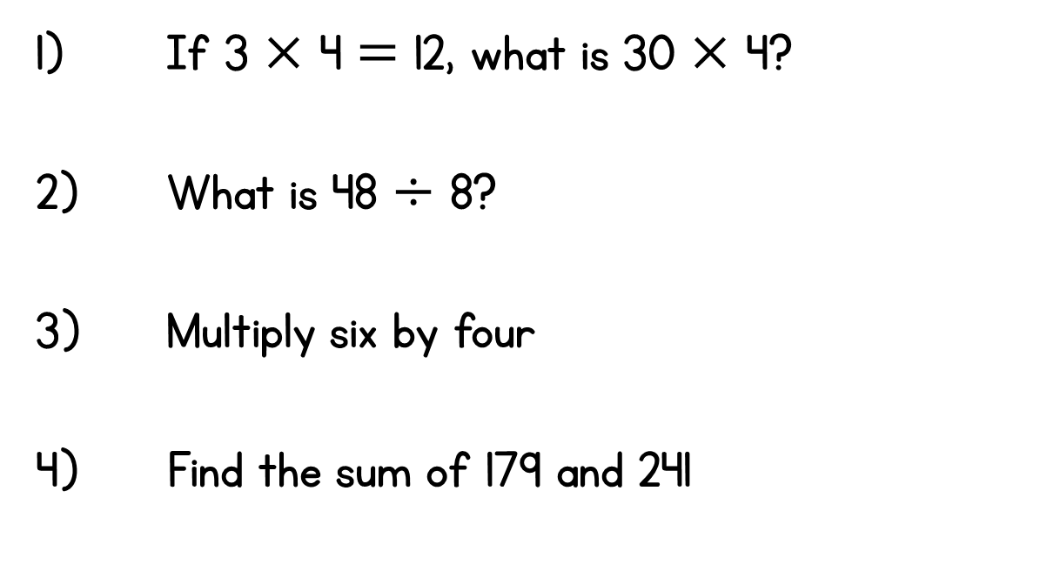
Year 3 | Week 1 | Day 4

Slide 5
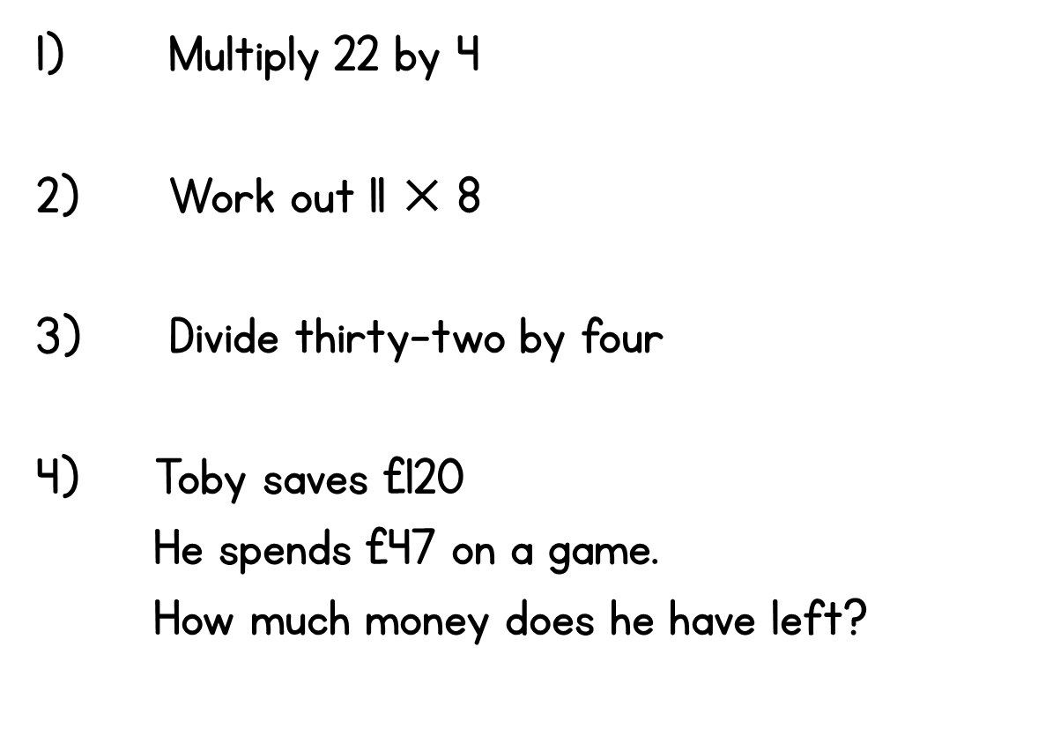
Year 3 | Week 1 | Day 5

Slide 6
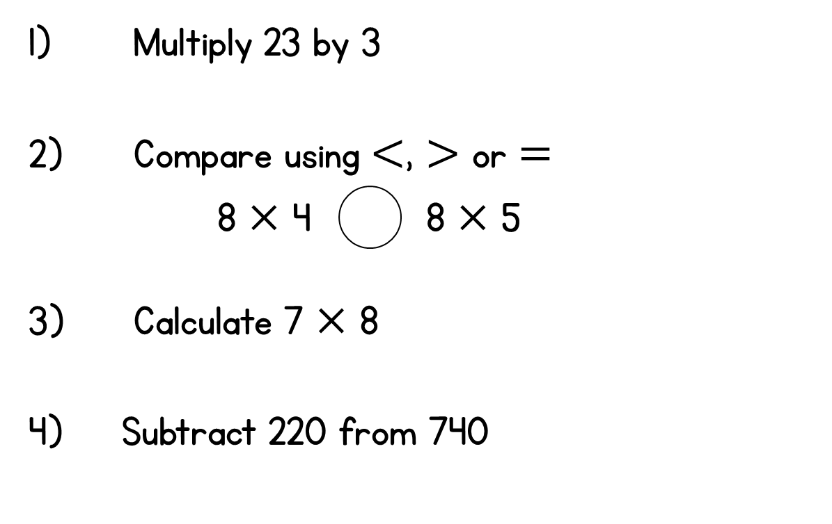
Year 3 | Week 2 | Day 1

Slide 7
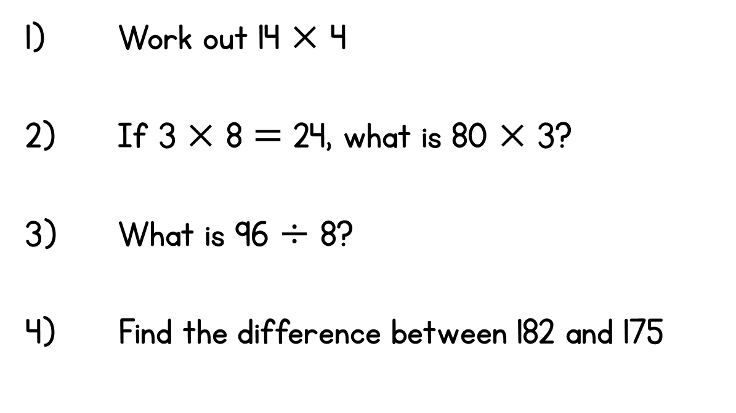
Year 3 | Week 2 | Day 2

Slide 8
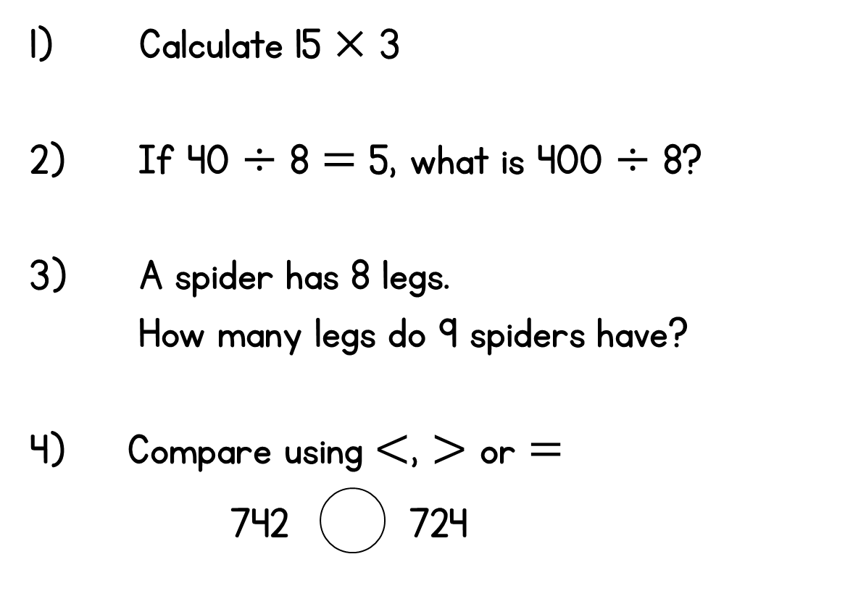
Year 3 | Week 2 | Day 3

Slide 9
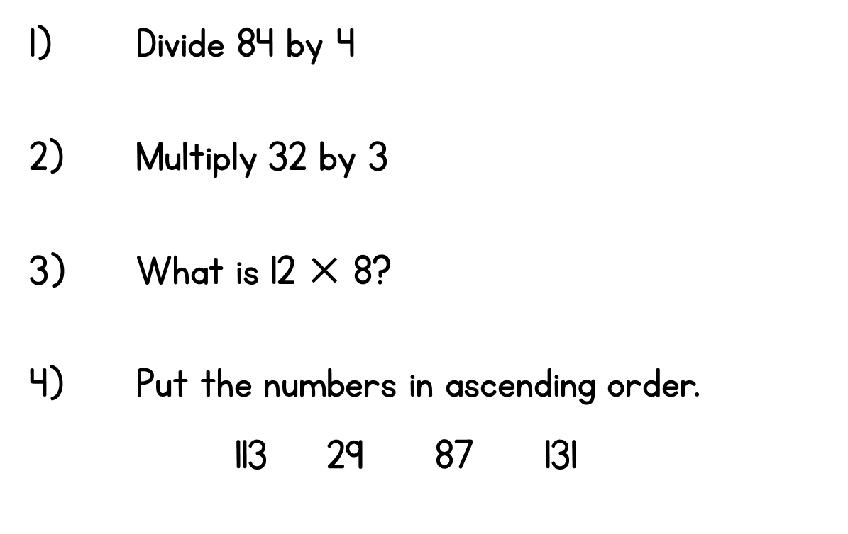
Year 3 | Week 2 | Day 4

Slide 10
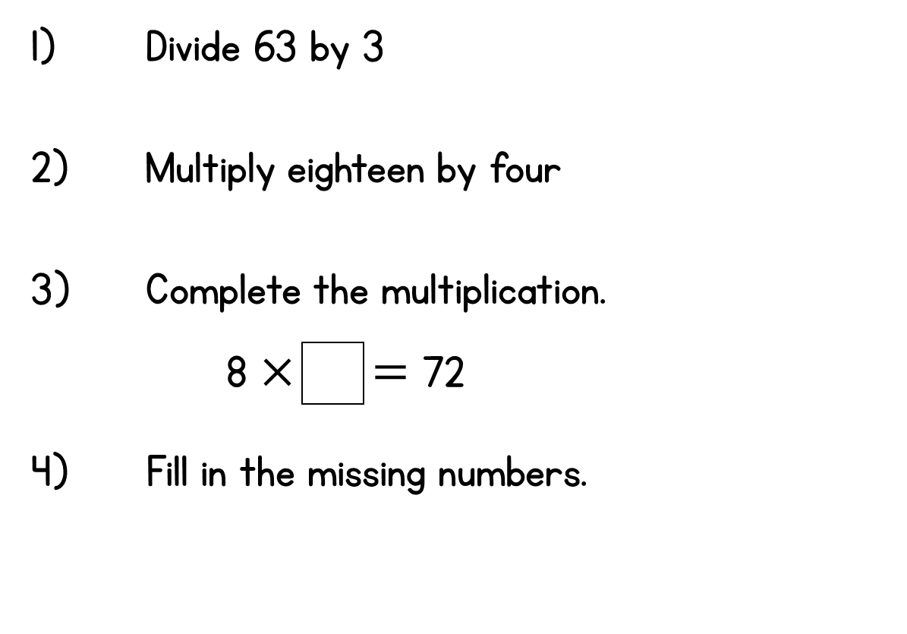
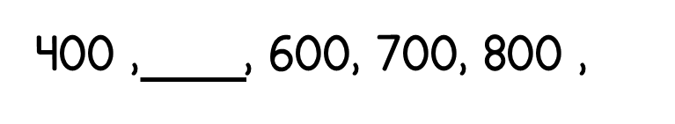
Year 3 | Week 2 | Day 5

Slide 11
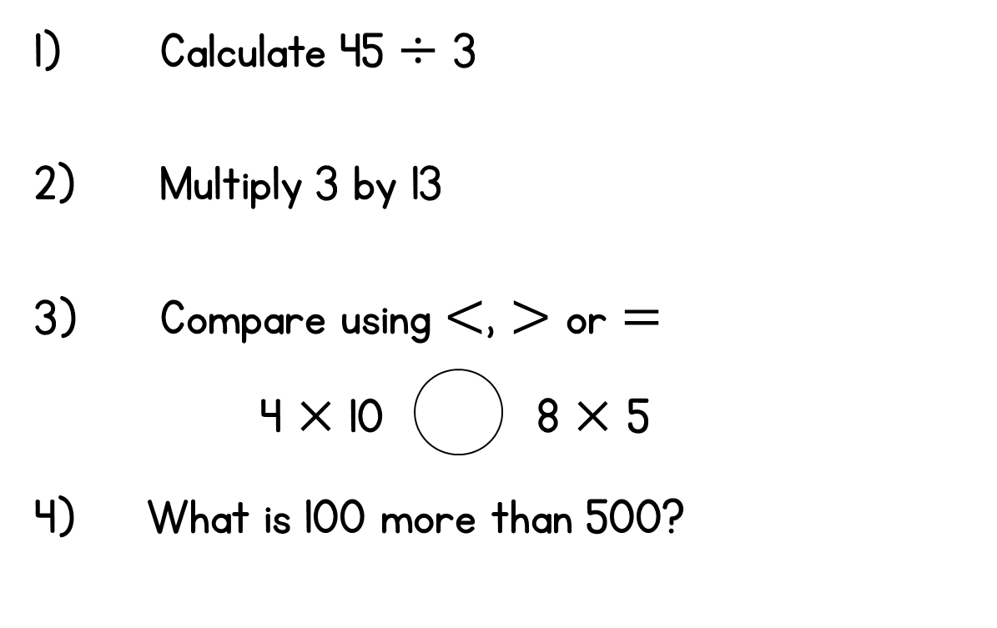
Year 3 | Week 3 | Day 1

Slide 12
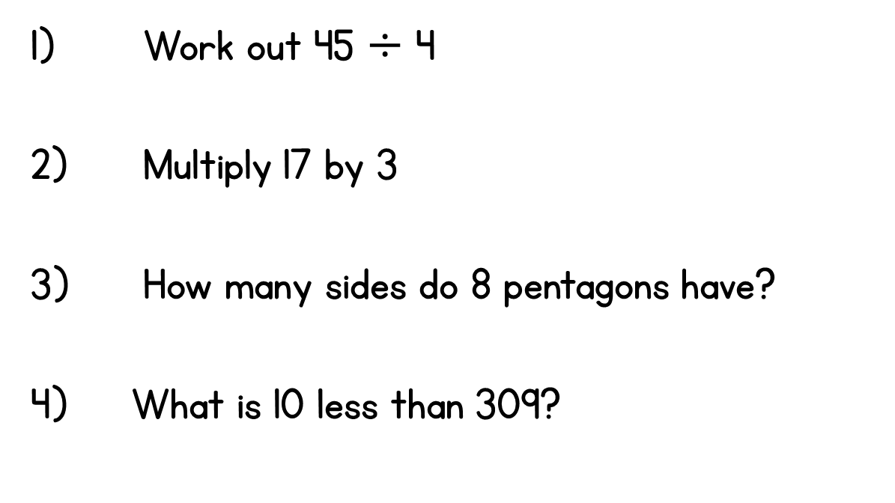
Year 3 | Week 3 | Day 2

Slide 13
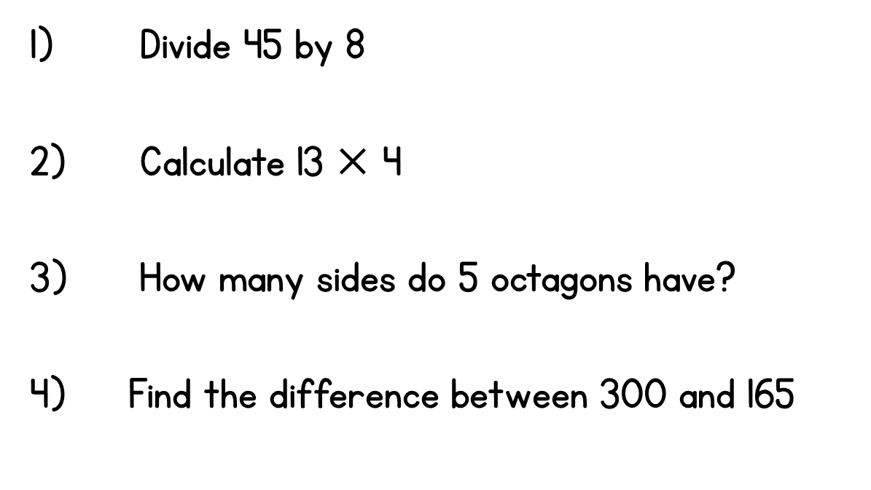
Year 3 | Week 3 | Day 3

Slide 14
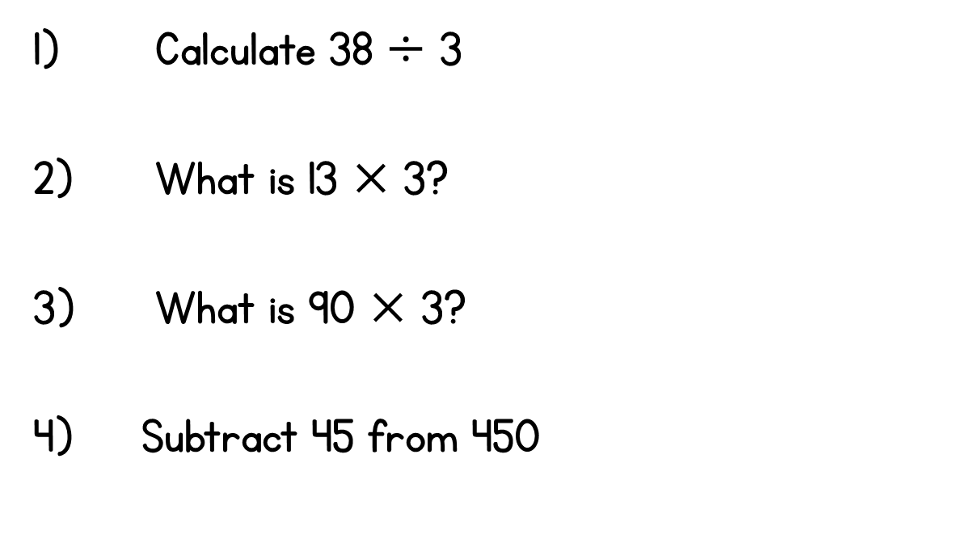
Year 3 | Week 3 | Day 4

Slide 15
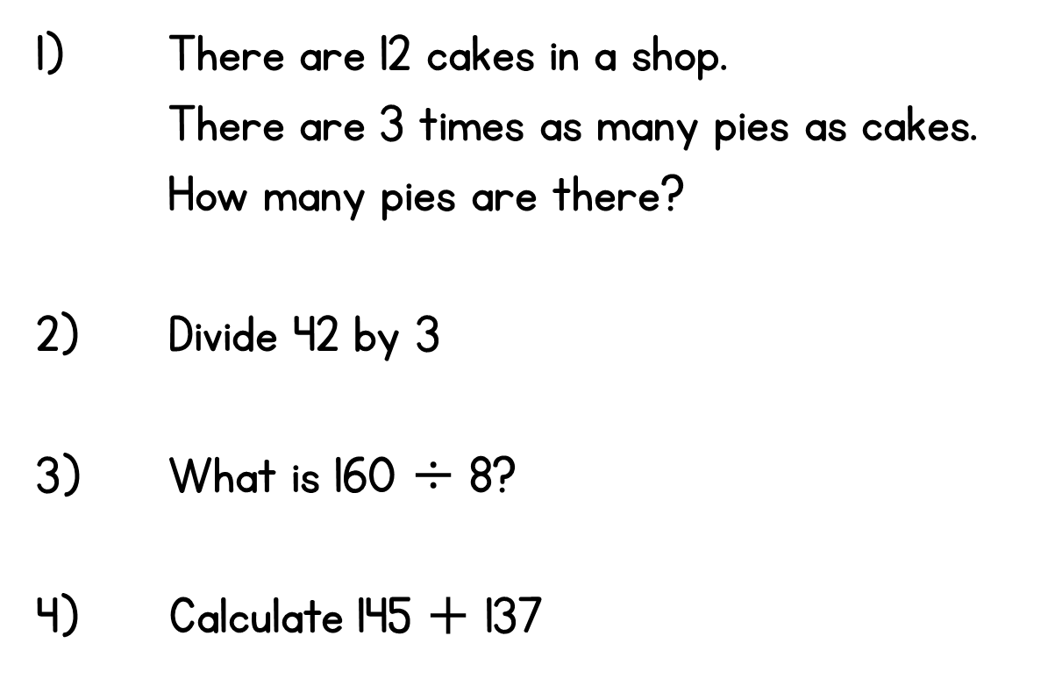
Year 3 | Week 3 | Day 5

